Slide 1
Improving Justice, Equity, Diversity, and Inclusion in Pediatric Research by Assessing and Addressing Language Barriers
Dr. Quynh Doan Senior Executive Director, BC Children’s Hospital Research Institute

Slide 2
Background
Canadians indicated a willingness (68%) to participate in clinical trials¹
Families at BC Children’s Hospital demonstrated an even higher rate of willingness (85%) to participate in pediatric health research²
Patients with Limited English Proficiency (LEP) are less likely to be approached to participate in clinical research compared with English-speakers³
Studies show that pediatric patients from a minority background were more likely to participate in studies where language translation was available⁴
Research lacking inclusiveness and diversity is unjust, ineffective, and not generalizable contributing to further population level health disparities
Notes:
BACKGROUND

Slide 3
Project Goals and Objectives
Increase the number of pediatric clinical studies that provide opportunities for individuals of diverse language backgrounds to participate
To ensure research output is generalizable to an inclusive population and that evidence-based care is provided in a just and respectful manner to all peoples
To transform the research culture to be more diverse, inclusive and equitable
To understand the barriers and facilitators to participation in research among LEP patients and families at BC Children’s
*Preliminary funding provided by a UBC SIF Grant
Notes:
OVERALL GOALS & OBJECTIVES OF THE LARGER PROJECT

Slide 4
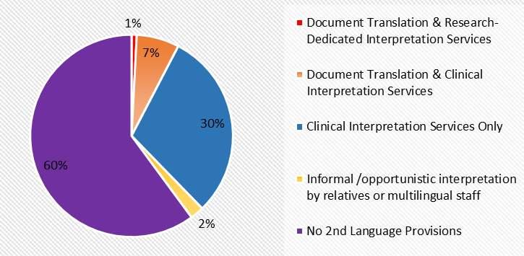
Understanding Current State
Review of 878 prospective studies submitted to the local research ethics board between 2017 & 2021
Results
Conclusions
144/878 (17%) explicitly excluded low English proficiency
441/878 (50%) had no provisions for language barriers
293/878 (33%) had at least partial 2nd language provisions to facilitate informed consent processes
Heavy reliance on clinical resources to support informed consent processes for research
Severe lack of research-dedicated 2nd language provisions at BCCHRI
Recommendations and Future Directions
Engage with research teams to determine barriers and facilitators to implementing effective 2nd language provisions
Standardize language provision requirements and institutional support for professional translation and interpretation
Pilot the provision of interpretation and translation resources by the research institute to estimate potential and cost for change
Figure 2: Description of 2nd language provisions implemented by prospective studies (n=1670) at BCHRI.
4
Notes:
MANUSCRIPT #1 (KEVIN) – REB REVIEW

Slide 5
Barriers identified by Local Researchers
A narrative inquiry approach was adopted to examine the experiences of researchers and hospital leaders
Semi-structured one-on-one interviews with 26 investigators, research staff, & hospital leaders
Recordings transcribed and line-by-line coding done through Nvivo
Manuscript submitted
Notes:
Semi-structured interviews with C&W research teams & hospital leadership - complete
Lack of translation/interpretation resources
Unclear Best Practices
Doubts about translation quality
Low prioritization
Increased funding/resources
Cultural competence and best practice training
Community partnerships,
Language-inclusive design.
Recognizing and addressing multi-level barriers can promote fully representative and equitable research participation for populations with LEP.

Slide 6
Interviews with Patients & Families with LEP
Semi-structured interviews conducted with 22 participants (caregivers & youth of families experiencing limited English proficiency)
Manuscript being drafted
Willingness to Participate:
Barriers to Participation:
Solutions to Improve Inclusion:
Positive motivations for participating in research, such as altruism and a desire for answers
Language challenges
Lack of cultural under-standing
Confidentiality concerns
Logistical issues - time & location constraints
Relationship and trust-building
Cultural awareness
Trauma-informed approaches
Negative experiences when don’t receive study results
Trust
Discrimination
Community partnerships
Enhancing research literacy
Fair reimbursement

Slide 7
National Researcher Survey
National survey conducted in English and French, and disseminated to 22 pediatric academic centres & research networks across Canada (n=162 respondents)
Top 3 barriers identified: (i) additional time needed to engage language services, (ii) cost of interpretation/translation services, and (iii) availability of language services
95% of respondents indicated would likely use more language services if services were available for free. In contrast, only 50% of respondents were likely to utilize a paid interpretation service if available
Notes:
MANUSCRIPT #4 (ALYSSA) – NATIONAL SURVEY WITH RESEARCHERS in Child health (facilitated by MICYRN

Slide 8
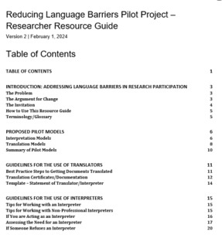
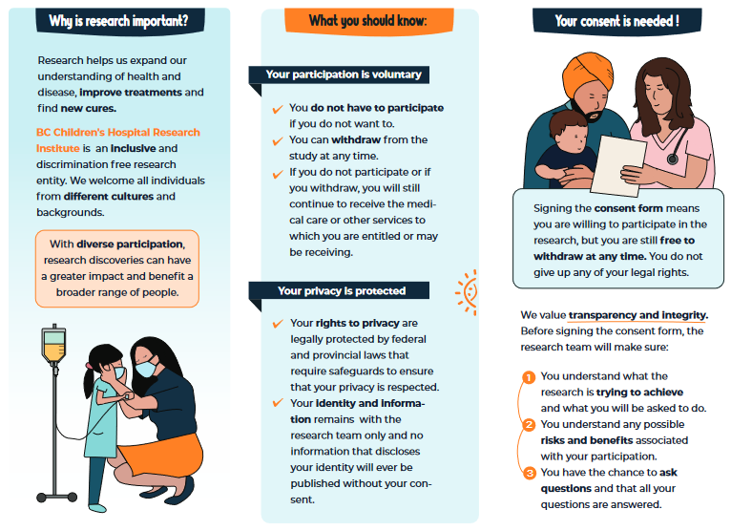
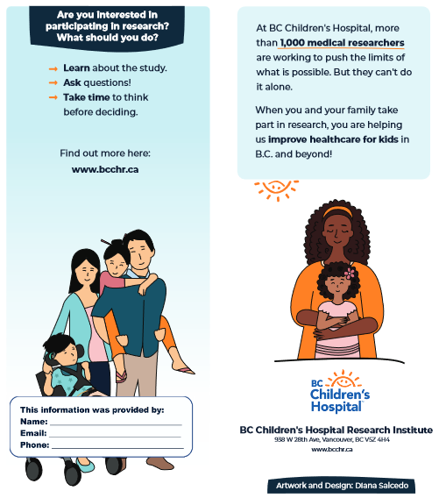
Language Pilot Project
https://bcchr.ca/participate-research
Pilot Project launched Spring 2024 (currently ongoing) to support local research teams
Provides: Resources, best practices, & funding for interpretation/translation support (includes generic research brochures (available in 10 languages) and a best-practices Resource Guide)
In early 2025, will analyze the data collected to evaluate experiences of researchers and research teams participating & the usefulness of the resources provided.

Slide 9
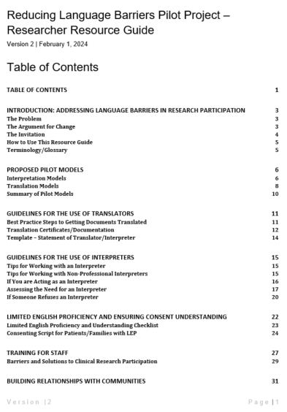
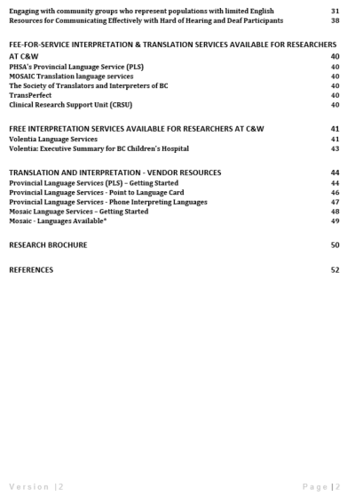
Develop a Model – Resources Generated
Generic Research Brochures In 10 languages, including: Arabic, English, Japanese, Persian, Punjabi, Simplified Chinese, Spanish, Tigrigna, Traditional Chinese and Vietnamese
2. Reducing Language Barriers Pilot Project – Resource Guide
https://bcchr.ca/participate-research
9
Notes:
INTRO TO PILOT ACTIVITIES

Slide 10
Next Steps for the Language Barriers Project
Continue to Pilot the model amongst existing research teams/studies
Evaluate the success of the pilot based on uptake, feasibility, cost
Refine/edit the Resource Guide
Review findings with Project Partners & Patient Advisory group to determine future projects and next steps
Advocate for dedicated funding to support language accessibility for research
10

Slide 11
Project Partners/Collaborators
Project Partners & Acknowledgements
BCCH Local Project Team
Project Advisory Committee
Patient Advisory Committee
Quynh Doan, Interim Senior Executive Director, BC Children’s Hospital Research Institute
Jennifer Claydon, Project Lead
Bonnie Barrett, Project Manager
Staff: Sarah Moreheart, Britt Udall, Sahajdeep Chhina, Cynthia Lee, Alima Suleimenova, Asli Ozer
Students: Bachviet Nguyen, Kevin An, Jiawan (Belle) Zhao, Alisha Temirova, Miriam Niazi, Alyssa Chong, Zelyn Lee, Samantha Pawer
Kiran Malli, Director, Provincial Language Services, PHSA
Alison Orth, Unit Director, Clinical Trials BC, Michael Smith Health Research BC
Ellen Chesney, Chief Administrative Officer, PHSA Research
Holly Longstaff, Director Privacy and Access, PHSA Research and New Initiatives, C&W REB Chair
Mary McKillop, Director, Patient Experience, BC Children’s & Women’s Hospitals
Dr. Manish Sadarangani, Director, Vaccine Evaluation Centre
Linda Warner, Patient Engagement Advisor, BC Children’s Health Bridge
Diana, Ani, Lama, Juliane, Mia
Community Partnerships
Riya Virdi & Lynda Li, Volentia Health Care Translation, University of British Columbia, Vancouver
Tanja Krzman and Diane Nixdorf, MOSAIC Settlement and Employment Services, Vancouver
Funders
UBC Faculty of Medicine, Strategic Investment Fund – Respect, Equity, Diversity & Inclusion Stream
BC Children’s Hospital Foundation
For more information or to be added to our mailing list, contact: jclaydon@bcchr.ca
Notes:
ACKNOWLEDGEMENTS

