Slide 1
Recognition and remuneration of patient partners in clinical trials
Clinical Trials Ontario conference
6 November 2024
Stuart Nicholls, on behalf of
Pascale Nevins, Grace Fox, Shelley Vanderhout, Jamie Brehaut, Kelly Carroll, Dean Fergusson, Beatriz Goulão, Alicia Hilderley, Colin MacArthur, Beth Potter, Maureen Smith, Anne Spinewine, Charles Weijer, Monica Taljaard

Slide 2
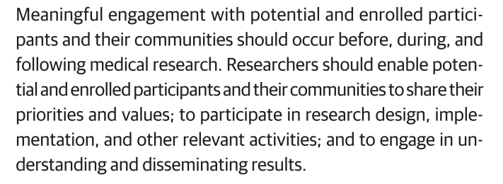
Patient and Public Involvement (PPI) in clinical trials
PPI, patient engagement, consumer engagement
“[R]esearch done with or by patients and the public, not to, about or for them. It is about working collaboratively with patients and the public and sharing decision-making” (UK)
“The idea is for patients, researchers, health care providers and decision makers to actively collaborate to build a sustainable, accessible, and equitable health care system to bring about positive changes in the health of people living in Canada. Engaging patients is thus an integral component in the development and implementation of all elements of SPOR […].” (Canada)
“This [patient engagement] should be a norm and embedded in an appropriate manner in all trials; it is not an optional extra […]” (WHO, 2024)
World Medical Association (2024). "World Medical Association Declaration of Helsinki: Ethical Principles for Medical Research Involving Human Participants." JAMA Published online October 19, 2024.: E1-E4.
World Health Organization (2024). Guidance for best practices for clinical trials. Geneva, Switzerland, World Health Organization.
Notes:
Patient and Public Involvement (PPI), which for the purposes of this talk I will be using synonymously with patient engagement or consumer engagement, is increasingly advocated for in clinical trials, and health research more generally. Indeed, the latest edition of the Declaration of Helsinki puts patient and community engagement front and centre as a component of ethical research.
ENDORSED by WMA

Slide 3
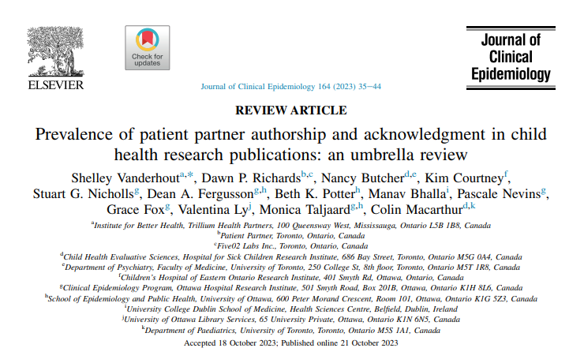
Demonstrating PPI is valued
Notes:
Need to flag equity here!!! Or EDI

Slide 4
Patient or Public (PPI) Partner Recognition
Recognition
Remuneration
Reimbursement
Offering goods or services in exchange for patient partnership (e.g. co-authorship, acknowledgement)
Offering something of monetary value in exchange for their engagement (e.g. honorarium, salary)
Reimbursement of out-of-pocket expenses from engagement (e.g. accommodation, travel costs)

Slide 5
Objectives
Among trialists who engaged PPI partners, what is the self-reported prevalence of:
Authorship or acknowledgement of PPI partners in the manuscript?
Remuneration for PPI partners?
Reimbursement for out-of-pocket expenses incurred by PPI partners?
Combinations of these forms of remuneration and recognition?
Notes:
We currently lack data from trialists themselves regarding their recognition, remuneration and reimbursement practices

Slide 6
Survey approach
Corresponding authors of pragmatic RCTs (Jan 1, 2014 - Apr 3, 2019).^{1,2,3}
Administered via Survey monkey to 3,163 unique authors.¹
Survey included a definition of PPI and respondents had to indicate that they had read and understood the definition
710 responses, 334 (47%) reported PPI
1. Vanderhout S, Nevins P, Nicholls SG, et al. Patient and public involvement in pragmatic trials: online survey of corresponding authors of published trials. CMAJ Open. 2023;11(5):E826-E837.
2. Nicholls SG, Carroll K, Hey SP, et al. A review of pragmatic trials found a high degree of diversity in design and scope, deficiencies in reporting and trial registry data, and poor indexing. J Clin Epidemiol. 2021;137:45-57.
3. Taljaard M, McDonald S, Nicholls SG, et al. A search filter to identify pragmatic trials in MEDLINE was highly specific but lacked sensitivity. J Clin Epidemiol. 2020;124:75-84.

Slide 7
Results: respondent demographics (n=334)
* Multiple selections allowed

Slide 8
How were PPI partners acknowledged in the manuscript or other materials? (n=300)*
* Multiple selections allowed

Slide 9
Were PPI partners remunerated (e.g., cash, vouchers, honoraria) for their involvement? (n=300)

Slide 10
Were PPI partners reimbursed for out-of-pocket expenses related to their involvement? (n=303)

Slide 11
Results: combination (n=274)

Slide 12
Discussion
15% provided none of the options, potentially creates barriers and makes PPI accessible only to the financially secure who can absorb costs
23% neither acknowledged PPI partners nor provided co-authorship, 53% did not provide remuneration, 24% did not provide reimbursement
No indication of a trend by year on any outcome
There is also a need to better understand the nature of any barriers that research teams and PPI partners face regarding recognition, remuneration, and reimbursement, in order to develop interventions that will address these barriers

