Slide 1
One Year Later: Progress Report on Advance Consent in Stroke Trials
Michel Shamy MD MA FRCPC
CTO Conference November 2024

Slide 2
Disclosures
I am a stroke neurologist, researcher, former REB member
Funding for this project from CIHR & New Frontiers in Research
Leadership roles with multicentre RCTs: ACT-GLOBAL, iCATCHER
No connections to industry
I am presenting on behalf of a team
Ubong Udoh, Emma Cummings, Rena Seeger & Brian Dewar
Co-PI Dar Dowlatshahi MD PhD

Slide 3
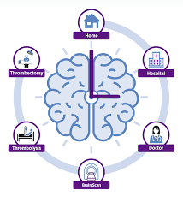
Let’s bring you up to speed
Acute stroke: sudden neurological event causing disabling symptoms
Until 30 years ago, felt to be untreatable
Major RCT successes have led to reorganization of care
Key element: “Time is Brain”
Treatment within 30 minutes of arrival in ER
Latest RCTs based on even faster timelines
It is standard of care to provide emergency treatment for acute stroke without first gaining consent

Slide 4
Consent for Acute Stroke RCTs
Because...
Potential participants are often incapacitated (and always under stress)
SDMs are rarely available (and always under stress)
Experimental & standard treatments must be administered very quickly
Standard of care is not to wait for consent
... Acute stroke RCTs use deferral of consent
Inform patient / SDM but do not seek consent until after acute treatment
Deferral of consent saves 20 mins & is broadly acceptable (>97%)
Could we improve upon this system with advance consent?

Slide 5
What is advance consent?
Inviting people with known cerebrovascular disease...
Hence who are at risk of stroke
... to give or decline consent in stroke prevention clinic...
... Ahead of an acute stroke and eligibility for trial participation
Would supplement standard consent procedures
Would only apply if they are incapacitated at the time
Consent documented in EMR
Analogous to principles of advance care planning

Slide 6
Why offer Advance Consent?
Respects autonomy of individuals to make their own decisions
Should not impede rapid treatment
Avoids inconsistencies around consent practices
Deferral of consent generally not permitted in Quebec, USA, Australia
Could address the under-representation of women in stroke trials
Establish experience relevant to other emergency conditions:
Cardiac arrest, MI, etc.
Surgery, Labour / puerperium

Slide 7
Background Research
~5% of patients will have stroke within 1 year of clinic visit (Lancet Neuro 2021)
Systematic review: advance consent tried in handful of emergency RCTs, never for acute stroke, never in Canada (BMJ Open 2023): mainly dementia & ICU
Stroke physicians: 82% comfortable with advance consent (CJNS 2023)
REB chairpeople: 60% comfortable with advance consent (CJNS 2023)
Stroke patients in AcT Trial: 97% ok with deferral, but 76% would have preferred to be asked ahead of time (Neurology 2024 in press)
Focus groups with PLE: Very interested, want it to be trial-specific, revocable, with a time limit (CJNS 2024)

Slide 8
ACTION: A feasibility study
Advance Consent for participation in acute stroke trials
With input from
Dr R Saginur, Chair of OHSNREB
Ms S Marlin, President & CEO of CTO
Dr P Lindsay, Head of Systems Change, HSFC
PIs of major Canadian stroke trials
Peer reviewers: 2 CIHR Grants, 1 New Frontiers in Research Grant
OHSNREB Review approved

Slide 9
Study Design
ACTION
1. Intake Questionnaire
2. Consideration of advance consent for acute stroke trial(s)
3. Tracking trial enrollment x 1 year
4. Exit Questionnaire
5. Staff Questionnaires
In stroke prevention clinic,
Identify patients at risk of stroke
Invite them to enter the study – consent to ACTION
Participants are asked their opinions about consent AND asked to consider consenting for either/both of 2 acute stroke RCTs
Only those most strongly in favour
Trials: EASI-TOC, FASTEST
Approved by REB
Using deferral of consent
Advance consent valid for 1 year
Participants can change their minds at any point

Slide 10
ACTION Launched July 2023...
PAUSED October 2023
OHSNREB discussed with other REBs, who were concerned whether Advance Consent is in contravention of TCPS2

Slide 11
Advance Consent & TCPS2
Nov 2023 Consultation with Mr. Tierry Laforce, Secretariat, PRE
Cited Section 3.8 on Emergency Consent:
“... prospective participants for emergency research are owed special ethical obligations and protection commensurate with the risks involved...[including] procedures to identify prospective participants in advance so that consent may be sought prior to the occurrence of the emergency situation...”
Just to be safe, we could call participants at 6 months to confirm that they had not changed their minds about having consented

Slide 12
ACTION restarted November 2023
Amendment: Now with phone call at 6 months to those participants who gave advance consent to make sure that they have not changed their minds
PAUSE Jan 2024
OHSNREB sought legal advice regarding advance consent

Slide 13
ACTION & HCCA
OHNSREB met with legal advisors who suggested that, under the Health Care Consent Act, advance consent must be confirmed with the patient or the SDM at the time of eligibility
Remember...
Informed consent has been given by a capable person
That person is now incapable (by definition)
The SDM is rarely available (that’s part of the problem)
We are trying not to delay treatment vs standard of care, which this requirement would seem to necessitate

Slide 14
ACTION restarted February 2024
Amendment: Now with requirement that consent be confirmed with the participant (incapable) or the SDM (rarely present)
Provided the opportunity to explore in a structured way the legal dimensions of consent to participate in research

Slide 15
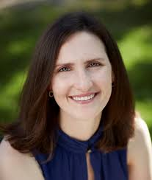
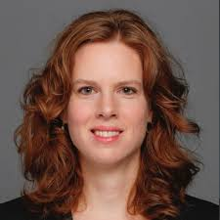
Current Progress: Legal Study
Identified scholars with expertise in health law
Professor Vanessa Gruben, U Ottawa
Professor Sophie Nunnelley, Toronto Metropolitan University
Recruited law student Marina Bredin to conduct a dedicated research project on:
Advance consent & HCCA
Advance consent in Canada
Research consent in Canada

Slide 16
Current Progress: Legal Study
1. Does the HCCA speak to consent to research? No.
HCCA does not apply to “a procedure whose primary purpose is research.”
Legal teaching is that it does not apply to research
Relevant guidance on consent to research should be the TCPS2
2. Does the HCCA speak to advance consent? No.
But it does speak to advance directives, which are different
3. Does the HCCA speak to the timing of consent? No.
Consent legislation & standards expect consent to precede participation but do not provide guidance on timing

Slide 17
Current Progress: Legal Study
In summary, this review of Ontario (and Canadian) law regarding consent, research, advance consent....
... Finds nothing in the HCCA that stipulates that advance consent must be confirmed with a patient or SDM at the time of enrollment under emergency circumstances
... Suggests that the TCPS2 should guide practice, which explicitly imagines emergency consent and encourages advance consent
... Asks: Why is advance consent not just... consent?

Slide 18
Current Progress: Enrollment
Completed enrollment July 2023 – July 2024
Total patients screened: 1547 (vs est. 2000)
Eligible patients: 431 (28% vs est. 40%)
Agree to be approached: 187 (43% vs est. 50%)
Completed survey phase: 157 (83% vs est. 100%)

Slide 19
Current Progress: Initial Survey
96% (151/157) agreed/strongly agreed that it is appropriate to invite stroke patients to provide advance consent to participate in research
95% (149/157) agreed/strongly agreed that they would provide advance consent to a specific stroke trial having reviewed the details
69% (108/157) agreed/strongly agreed that they would provide advance consent to all acute stroke trials, even without knowing the details

Slide 20
Current Progress: Advance Consent
Based on survey responses, 110 patients were invited to give advance consent if they wished
47/110 patients gave advance consent (45% vs 50% expected)
36 to both trials, 6 to EASI-TOC only, 2 to FASTEST only
1 withdrew their advance consent
1 gave advance consent to decline participation in acute stroke trials

Slide 21
Current Progress: 6 month Check-In
Of the 46 patients who gave advance consent, 21 have reached their 6-month check
Of these, 17 have been contacted & all 17 chose to keep their advance consent
4 patients have not yet been contacted

Slide 22
Current Progress: 12-month Close Out
Of the 157 patients who took the initial survey, 32 have reached 12-month close out
20 have completed the final questionnaire and exited the study
4 are lost to follow-up (2 deceased, 1 incapacitated, 1 unreachable)
8 have yet to be contacted
2 have had stroke events within the last year, but neither had given advance consent.
Of the 3 participants who gave advance consent and have completed the study, all expressed being happy with their decision.
No recruitment as of yet

Slide 23
Quotations From Exit Interview
"I'm a big believer in research and am surrounded by people who are physicians (wife, son, daughter) so I always counted on them to make the right decision for me if any research study came around that I was incapacitated for, but after reflecting on my diagnosis, none of them were close by when the emergency happened, so maybe advance consent would be the way to go. I definitely think there's something worthwhile there, can I still sign up?"
“I have a family history of cardiovascular disease, so it was very important for me to stay ahead of the curve and give my own consent to research."

Slide 24
Summary
Enrollment into our feasibility study of advance consent is complete
12 month follow ups due to finish July 2025
Patients with cerebrovascular disease are overwhelmingly open to giving advance consent
Of those offered to do so, about 45% gave advance consent to a specific RCT
So far, this has not translated into enrollment
The ethical and legal standing of advance consent appears strong

Slide 25
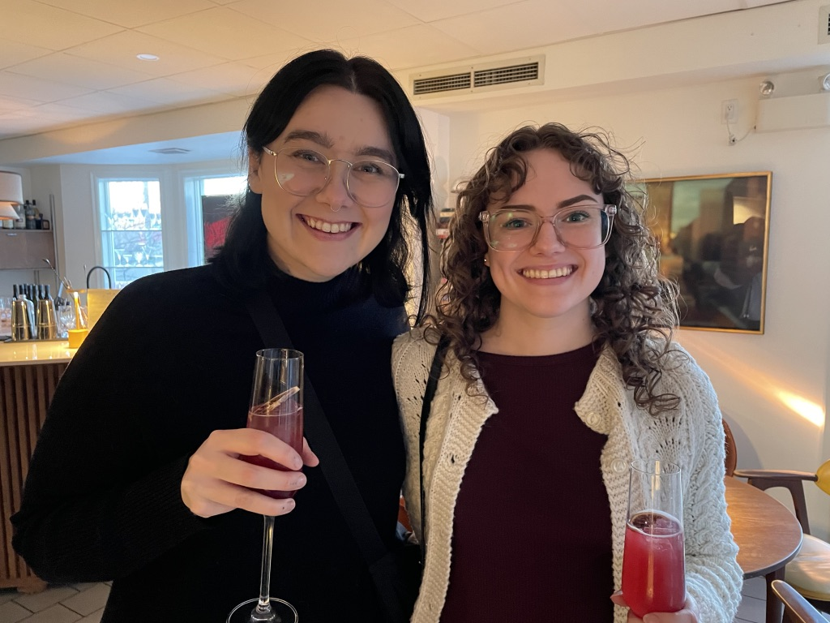
Questions?
mshamy@toh.ca
Thanks to those who completed our surveys & focus groups
Thanks to the patients who made this study possible

