Slide 1
Trust Matters: Partnering with the New Immigrant Community in Clinical Research
Munaza Jamil

Slide 2
The Multicultural Landscape
In recognizing the cultural diversity of Canada, it is essential to first acknowledge the Indigenous peoples who have lived on these lands for millennia.
Alongside this foundational presence, Canada is home to a richly diverse population, with 23% being foreign-born. According to Statistics Canada, by 2041, 34% of the population of Canada would have been born outside of the country.
Additionally, over 7.7 million identify as members of visible minority groups, accounting for 22.3% of the population.
Just over 1.3 million new immigrants settled permanently in Canada from 2016 to 2021, the highest number of recent immigrants recorded in a Canadian census.
Source: Statistics Canada [https://www.statcan.gc.ca/en]

Slide 3
Why is this group important?
The “healthy immigrant” effect
Immigrants, including refugees and asylum seekers, have unique lived experiences that expose them to some significant physical and mental health challenges.
Refugees are particularly vulnerable to injury, abuse and trauma.
Pre migration trauma and post migration stressors put them at a higher risk of developing physical and mental health concerns that may benefit from specialized attention in CTs.

Slide 4
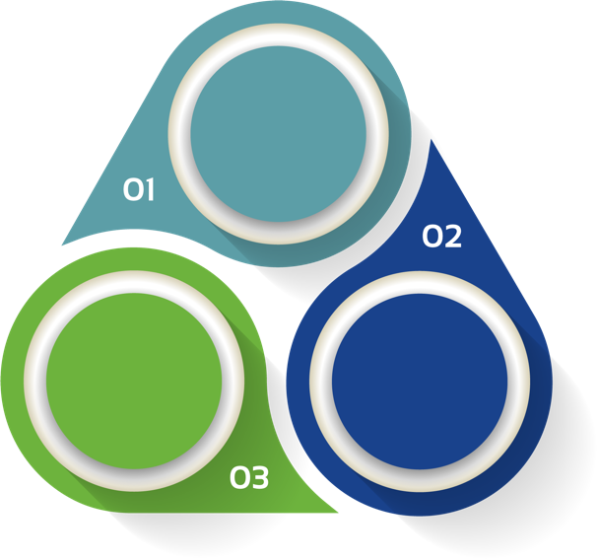
CAFÉ SCIENTIFIQUE
March 2023: N2 PEC Committee submitted application to CIHR.
Oct 2023:Workshop was held in Toronto
June 2023: CIHR Grant Awarded for Workshop with New Immigrants to Canada
PI: Dr. Rachel Syme, University of Calgary

Slide 5
Enable the ​clinical trial’s​​ community to develop effective materials to engage new immigrants in ​clinical trial’s​​
Increased awareness and understanding of ​clinical trials​​ within new immigrant communities
OBJECTIVES OF THE CAFÉ
Increased understanding of the barriers that newcomers experience to participating in clinical trials
Create a model for future workshops that enables the​ clinical trial​​ sector to host them within their own community

Slide 6
Awareness
Trust
Cultural Values
Many attendees shared preference to learn about CR in group, community settings.
Misconceptions stem from varying experiences in their home countries, where individuals feel they were treated as "guinea pigs" for testing new drugs.
The need for researchers to understand and address cultural and contextual sensitivities, including religious factors, was emphasized
Many do not trust online websites, and prefer in-person, F2F interactions, when learning about clinical research
Concern that doctors are motivated by financial gain, and will encourage patients to enroll in the trial
Women in some cultures and faiths, prefer to interact with gender-matching personnel, particularly in a clinical context
SUMMARY OF LEARNINGS
Communication
Transparency
Language
People expressed difficulty communicating and their want to have their family involved in decisions.
Concerns about receiving a placebo, not receiving updates on their condition, or that doctors are being paid to do the trial.
New Immigrants would benefit from clinical trials related materials, translated into their language to help them understand better.
Attendees wanted to learn from people with similar lived experiences who had participated in clinical trials, as it would increase trust,reduce hesitancy
Linguistic matching staff on study teams, can help translate for participants in a culturally-sensitive manner.
What will you do with my data?
Is randomization really random?

Slide 7
Awareness and Education
For a lot of new immigrants, even finding a suitable health care provider is a challenge.
Navigating the health care system can be harrowing!
Refugees and asylum seekers may not have proper health care coverage, making them ineligible to participate in a clinical trial.
Many do not trust online websites, and prefer in-person, F2F interactions, when learning about clinical research.
Many attendees stated a preference to have group sessions to promote education
and awareness regarding clinical trials, especially in a community setting.

Slide 8
Trust
Misconceptions stem from varying experiences in their home countries, where individuals feel they were treated as "guinea pigs" for testing new drugs.
In some nations, where healthcare is privatized, citizens must pay for health services. There’s a real concern that doctors, motivated by financial gain, might actively encourage patients to participate in clinical trials.
Depending on an individual's status in Canada, the level of trust concerning the sharing of personal information may be particularly heightened, adding an extra layer of stress.

Slide 9
Cultural Sensitivity and Competence
The need for researchers to understand and address cultural and contextual sensitivities, including religious factors, was emphasized.
Women in some cultures and faiths, prefer to interact with gender-matching personnel, particularly in a clinical context.
In some cultures, decisions are made as a family, not as an individual.
Immigrants often undergo traumatic experiences that influence their thoughts and perceptions, potentially impacting how they view medical research and, consequently, shaping their perceptions of clinical trials.
Through awareness and knowledge, researchers would be better equipped to understand and identify barriers faced by communities, with the ability to address them to increase involvement.

Slide 10
Communication
Many emphasized the importance of “seeing people like you” represented in recruitment materials, and patient- facing documents in clinical trials.
The impact of hearing from peers who have lived experiences as immigrants is significant; fosters trust, reduces hesitancy.
Importance of involving caregivers and family members in discussions around participation in clinical trials.

Slide 11
Transparency
A recurring theme was the concern over perceived risks associated with the experimental clinical interventions, leading to hesitancy among participants to engage in the trials.
Participants said they would like to be well informed about the mechanism of the agents being utilized, and whether it would be safe or worsen their condition.
Many also had concerns about whether researchers would discontinue the interventions if no improvement was seen.
Additionally, if an adverse event took place, they were unfamiliar with reporting and how it was ensured that their health was protected.
Other concerns included the use of placebo’s, as well as any fiscal incentives for the researchers.

Slide 12
Language
Clinical trials related materials should be translated in various languages.
Linguistic matching staff on study teams, can help translate for participants in a culturally-sensitive manner.
Important to consider language used in patient-facing materials, ie “compensation vs incentive”
Fun Fact: Although Canada has two official languages (English and French), more than 200 languages were reported in the 2016 Census of Population as a home language or mother tongue.

Slide 13
Call to Action
Develop a cultural and ethnically diverse clinical trials workforce.
Cultural competence training is a must for research teams.
By building trust through community relationships, tailoring communication to be culturally relevant and accessible, and addressing logistical barriers to participation, research teams can effectively and meaningfully, engage with new immigrant populations in clinical trials.

Slide 14
Stay Connected!
To learn more about the findings from the Community Consultation we conducted, please read:
White Paper: Bridging the Gap
If you would like to learn more about how you can plan your community engagement event, please see our DIY Engagement Event Toolkit
N2 DIY Event Engagement Toolkit
You can learn more about the Committee’s efforts here:
N2 Public Engagement Committee - N2 Canada
Go to: www.n2canada.ca/resources and click on Public Engagement

Slide 15
References
Government of Canada. (2023, July 7). Best practices in equity, diversity and inclusion in research practice and design. Best Practices in Equity, Diversity and Inclusion in Research. https://www.sshrc-crsh.gc.ca/funding-financement/nfrf-fnfr/edi-eng.aspx
Corneli, A., Hanlen‐Rosado, E., McKenna, K., Araojo, R., Corbett, D., Vasisht, K., Siddiqi, B., Johnson, T., Clark, L. T., & Calvert, S. B. (2023). Enhancing diversity and inclusion in clinical trials. Clinical Pharmacology & Therapeutics, 113(3), 489–499. https://doi.org/10.1002/cpt.2819
Skalicky, A., & Hareendran, A. (2021). Enhancing clinical trial diversity in the era of decentralized trials: The value of patient insights. The Evidence Forum. https://www.evidera.com/white-paper-enhancing-clinical-trial-diversity-in-the-era-of-decentralized-trials/
Palumbo, P., Hong, P., Marsh, M., O’Brien, S., Poopat, C., Toal, C., Andrews, M., & Sanchez, H. (2022). WHITE PAPER: Diversity in clinical trials participation: A life sciences perspective. Trinity Life Sciences. https://trinitylifesciences.com/wp-content/uploads/2022/05/Trinity-Whitepaper-Diversity-in-Clinical-Trials-Participation.pdf
Canadian Institutes of Health Research. (2023). What we heard report: Future of clinical trials. https://cihr-irsc.gc.ca/e/53429.html
Natural Sciences and Engineering Research Council of Canada. (2023, June 6). NSERC guide on integrating equity, diversity and inclusion considerations in research. NSERC. https://www.nserc-crsng.gc.ca/NSERC-CRSNG/Policies-Politiques/EDI_guidance-Conseils_EDI_eng.asp
Statistics Canada. (2022, October 26). Immigrants make up the largest share of the population in over 150 years and continue to shape who we are as Canadians. The Daily. https://www150.statcan.gc.ca/n1/daily-quotidien/221026/dq221026a-eng.htm
Jindal, R. M. (2020). Refugees, asylum seekers, and immigrants in clinical trials. The Lancet, 395(10217), 30–31. https://doi.org/10.1016/s0140-6736(19)32529-2
Hernandez, M., Franco, R., Kopelowicz, A., Hernandez, M. Y., Mejia, Y., Barrio, C., & López, S. R. (2019). Lessons learned in clinical research recruitment of immigrants and minority group members with first-episode psychosis. Journal of Immigrant and Minority Health, 21(1), 123–128. https://doi.org/10.1007/s10903-018-0704-y
Willison, D. J., Richards, D. P., Orth, A., Harris, H., & Marlin, S. (2019). Survey of awareness and perceptions of Canadians on the benefits and risks of clinical trials. Therapeutic Innovation & Regulatory Science, 53(5), 669–677. https://doi.org/10.1177/2168479018805433

