Slide 1

Ontario’s Hard Pivot to Life Sciences
Nov. 2024

Slide 2
Previously, on Life Sciences in Ontario…

Slide 3
I Believe Life Sciences is Canada’s Greatest Untapped Opportunity to Help People

Slide 4



The Life Sciences Opportunity
What are we missing out on if we fail to accelerate our life sciences companies?
Combined market capitalization of US $317.3B
The entire Canadian Oil & Gas Sector
is US $290.3B
(134 companies listed on the TSX/TSXV)
Oct. 2023
Sept. 2023
Combined US $374B
Nov. 2024
(129 Combined) US $274B
Sept. 2024

Slide 5
“We have all the ingredients but lack a recipe”
-Kevin Lynch, Vice-Chair, BMO, 2013
so where is our Blackberry
of biotech?

Slide 6

Announced Mar. 31, 2022
Grow Ontario’s biomanufacturing footprint
Build domestic resiliency in PPE and critical medical supplies
Boost commercialization capacity of Ontario companies and startups –
Adopt Ontario innovation to improve healthcare
It will also establish a forward-looking life sciences council that will focus on long-term growth and competitiveness
https://www.ontario.ca/page/taking-life-sciences-next-level-ontarios-strategy

Slide 7
Life Sciences Council
Strategic Growth and Investment: (May 16, 2023)
Sustaining and Unlocking Capital: (June 2, 2023)
Building Pathways to Adoption: (June 22, 2023)
Research and Commercialization: (July 14, 2023)
Talent Development: (August 18, 2023)
Leveraging Data: (September 14, 2023)

Slide 8

“We have all the ingredients and multiple recipes. Now it’s time to get cooking!”
-Jason Field, 2021

Slide 9


Slide 10
This Season, on Life Sciences in Ontario….

Slide 11


BIO2024 Conference, June, San Diego
“Ontario’s Hard Pivot to Life Sciences”

Slide 12
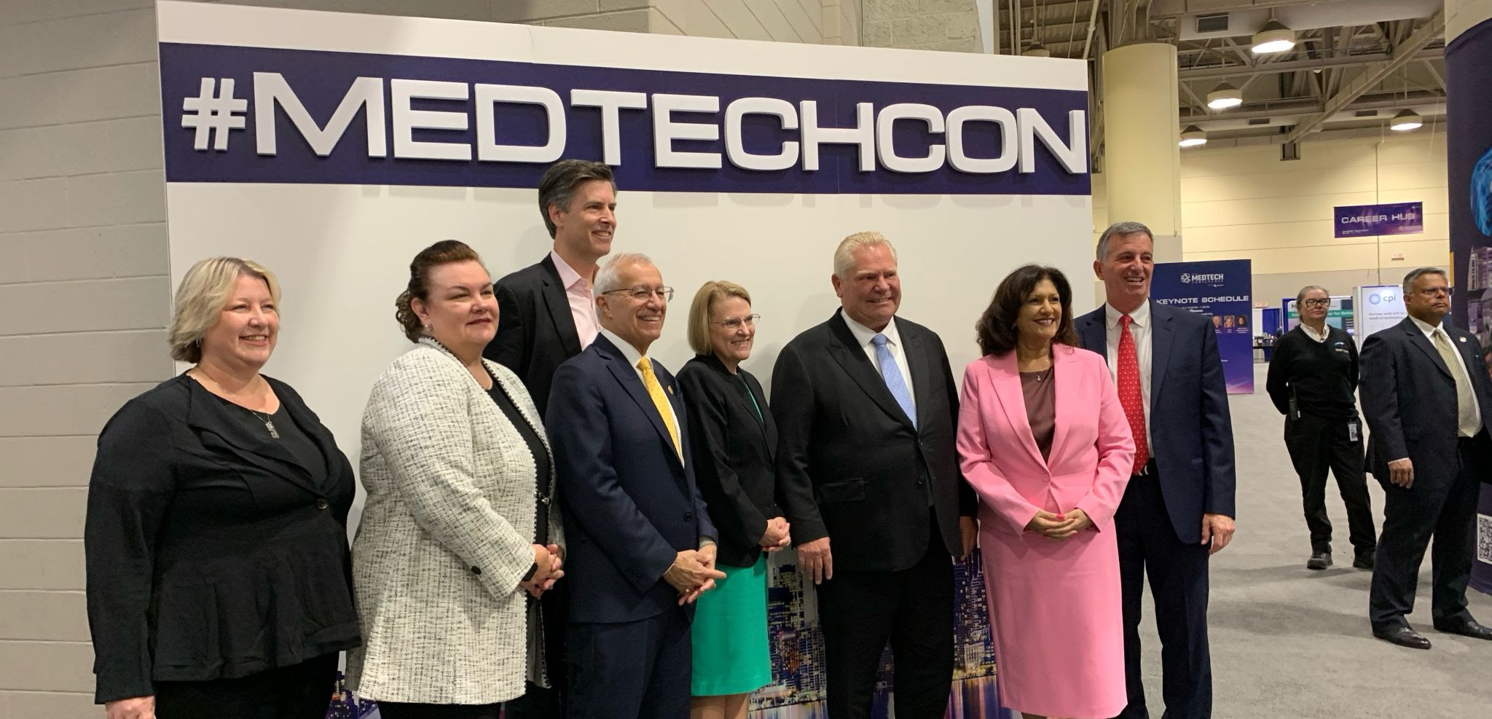

MedTech Conference

Slide 13
Phase II of Ontario’s Life Sciences Strategy
A $146 million investment to help fuel the sector’s growth:
Up to $46 million CBRIF match to boost research at postsecondary institutions and affiliated research hospitals.
$15 million for a new wet labs program.
$5 million for Clinical Trials Ontario's QuickSTART Initiative to speed up health trials.
$24 million for a new Life Sciences Scale-Up Fund (LSSUF) that will act in tandem with the $12 million Health Technology Accelerator Fund (HTAF), announced in the 2024 Budget.
$40 million from the Venture Ontario Fund to invest in venture capital funds that will help Ontario-based life sciences companies and biomanufacturers innovate and grow.
Phase 2 will also include the launch of the new Health Innovation Pathway, designed to streamline and simplify access for health care organizations to adopt transformative technologies with a priority placed on supporting Ontario-based innovations.

Slide 14
The “Invisible” Wins
The Process
  All of government approach
  Meaningful engagement across diverse stakeholders
  Empowerment of public service
The Engagement
  Premiers Office
  Multiple Ministers
  Multiple Organizations

Slide 15
Preview of Next Season, on Life Sciences in Ontario….

Slide 16

Contact
jason.field@lifesciencesontario.ca
www.lifesciencesontario.ca
@LifeSciencesON

