Slide 1
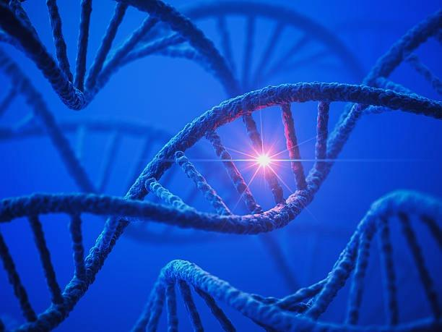


The Precision Patient
My Experience With Rare Cancer and Clinical Trials
Presented by:
Allen Chankowsky
November 6, 2024
@allenchankowsky

Slide 2

My cancer experience and why I owe my life to precision medicine
The importance of my advocacy work and the inclusion of the patient voice
Objectives
A shining example of an innovative decentralized clinical trial in the United States
An example of a Canadian patient-centric clinical trial model at the funding stage

Slide 3

Allen’s Long Journey (33 Years & Counting)
Notes:
1988
1991, clandestine
Radiation
Move to Toronto, F/U PMH
Married, kids, career, divorce, you know…
2012 (43) Best shape of my life, 1st half-marathon. MI….
stents…good as new. Yeah right…
2016 – lump on neck – Bx. 47 – 25 years post radiation
Initial approach was Radical neck dissection
The pathology from the surgery confirmed SDC. Many Pos LN – Stage-4!!
The most aggressive and lethal form of salivary gland cancers - ultra-rare >6/100k
Needed more radiation.
Radiation 2 x / day for a month – moved downtown

Slide 4
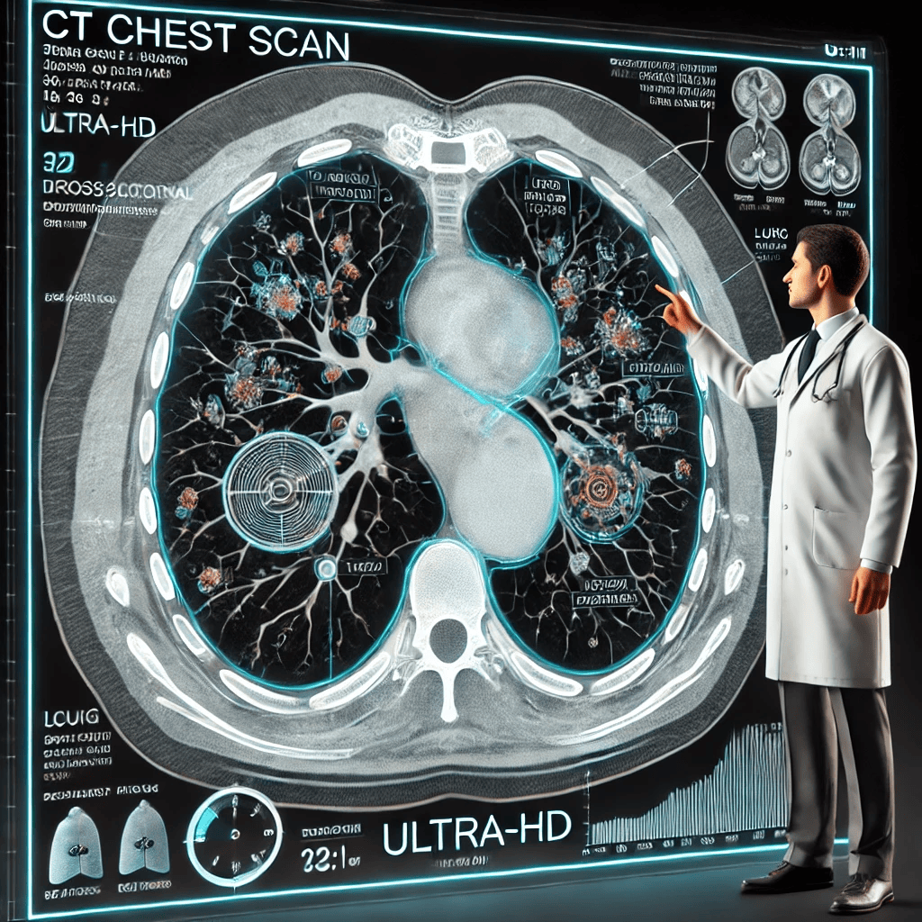
CT Chest Report – January 2017
(Impression)
Increase in Pulmonary Nodules
Increase in size of multiple pulmonary nodules, highly suspicious for metastases.
Ground-Glass Foci and Growth
Increase in size and number of patchy ground-glass foci.
Lymphadenopathy Observations
New mediastinal and left hilar lymphadenopathy. Appearance of metastases or multifocal lung adenocarcinoma are favoured.
Notes:
Post radiation CT Chest not good
I needed to educate myself more and learn all I could about this disease before making significant decisions.
So I decided to wait til March to see what the next scans were gonna show
But I also did something very quietly in the background. I met with two lawyers to get my will up to date.
I saw the writing on the wall. I felt that I needed to prepare for what I thought was the inevitable.
Then 3 months after that in March, more radiographic evidence re-confirmed that the inevitable was coming

Slide 5
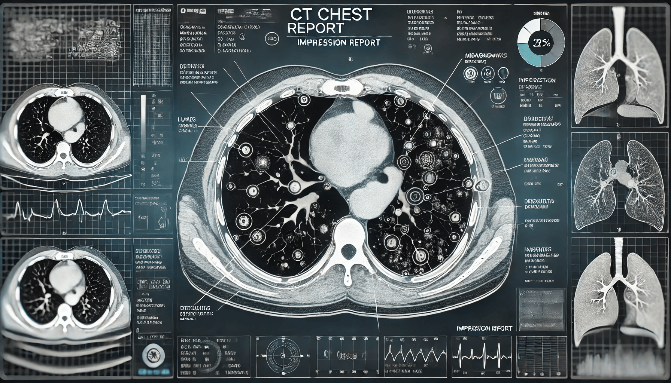
CT Chest Report – March 2017
(Impression)
Nodularity in Lower Lobe
More nodularity in relation to a sub solid opacity in the lower lobe on the left. Imaging features represent progressive areas of multifocal adenocarcinoma with developing invasive adenocarcinoma.
Nodules and Nodes
Additional solitary nodules are noted. Highly suggestive of growing metastatic deposits.
Notes:
Confirmation – SDC spread - TERMINAL
I knew what was coming. SOC was pal chemo. Wasn’t ready to begin palliative anything
Feeling of utter devastation – kids 12 and 9 – parents
Had to do something different
Started a research project
Quickly learned that sending my tumour out for CGP was the only way of extending my life.
We learned that we needed to understand the biology of my tumour. Driving its growth? Weaknesses?
METASTATIC - The location no longer mattered
We researched companies and organized that the tumour be sent to the USA for CGP
Report came back in 2 weeks

Slide 6
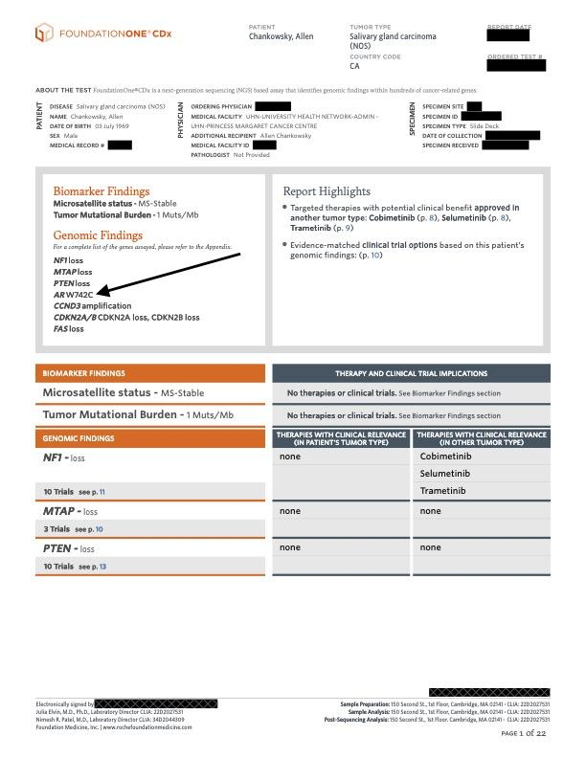
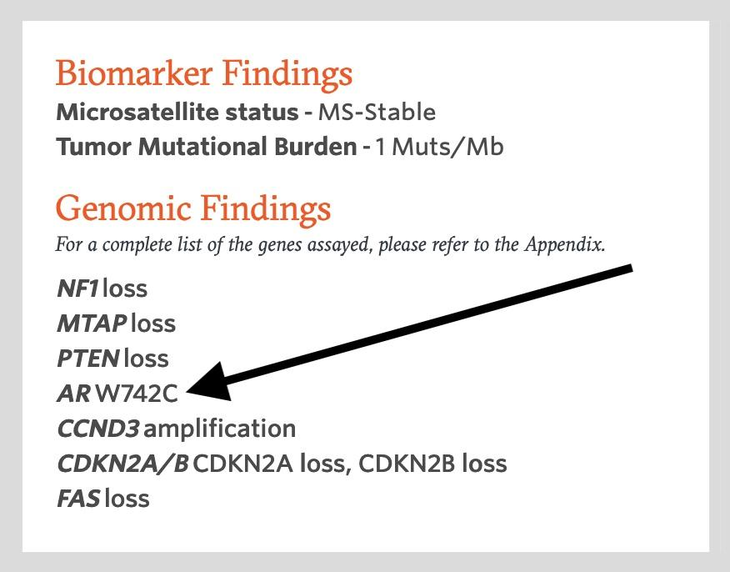
Next Generation Sequence Report
Notes:
AR positive. Now we had a target!!!!
We scoured the web for ANY info on AR as it related to SDC
C and I read hundreds of peer reviewed journals. A lot on SDC and a lot on AR expression but….not much with the overlap because SDC is so rare.
But we did come across a few reports on patients that showed much longer survival using ADT

Slide 7
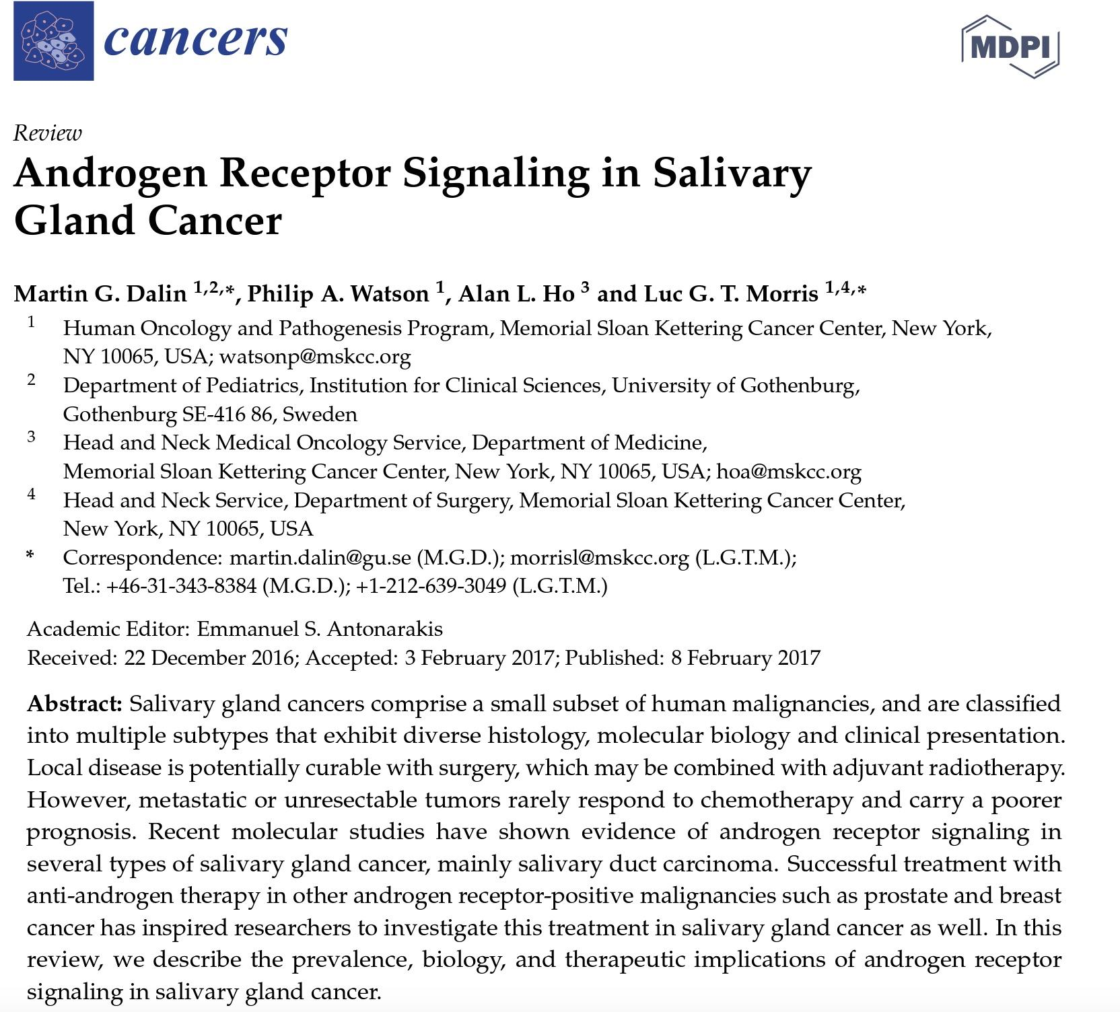
Androgen Receptor Signaling & Salivary Duct Carcinoma

Slide 8
Androgen Receptor Signaling & Salivary Duct Carcinoma
01
Classification and Diversity
03
Metastatic Tumor Challenges
Salivary gland cancers comprise a small subset of human malignancies and are classified into multiple subtypes that exhibit diverse histology, molecular biology, and clinical presentation.
Recent molecular studies have shown evidence of androgen receptor signaling in several types of salivary gland cancer, mainly salivary duct carcinoma.
Local Disease Treatment
Androgen Receptor Studies
02
04
Local disease is potentially curable with surgery, which may be combined with adjuvant radiotherapy. However, metastatic or unresectable tumors rarely respond to chemotherapy and carry a poorer prognosis.
Successful treatment with anti-androgen therapy in prostate and breast cancer has inspired research into its use for salivary gland cancer. This review covers the prevalence, biology, and therapeutic implications of androgen receptor signaling in salivary gland cancer.
Notes:
I wasn’t sure what to do
Booked 2nd opinion appointment at Memorial Sloan Kettering in NYC
Booked a 3rd opinion at MD Anderson in Houston
Both told me to NOT do the ADT and to try the chemo first – surprising actually
It was game time and I had to make my first treatment decision
We brought the peer-reviewed journal reports with us in support of ADT
She literally had the chemo induction papers in her hand for me to sign
Declined the palliative chemo
Nothing to lose – started ADT
I had ONE (1) injection of ADT between March 2017 and June 2017
In June, I had re-staging CT’s and this is what happened

Slide 9
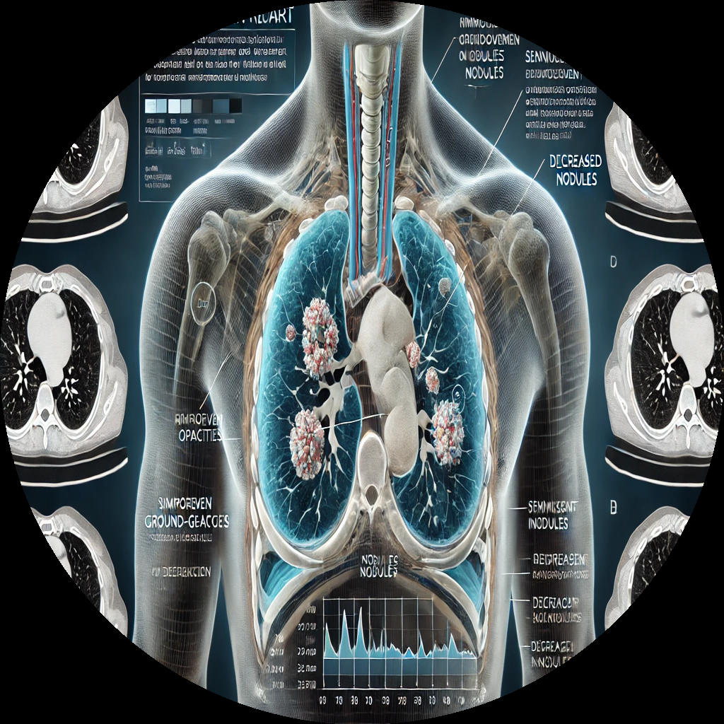

CT Chest Report – June 2017
(Impression)
Improvement in Ground-Glass Opacities
Significant improvement in bilateral ground-glass opacities. The significant resolution of these changes would support drug-related changes.
Decrease in Nodules
Solitary nodules have also decreased in size. Strong likelihood of metastatic lung nodules that are decreasing in size.
Notes:
Very emotional response
Is this real? Is this durable?

Slide 10
The Importance of the Patient Voice
Notes:
Couldn’t keep this news to myself.
Needed to get out there and live my NEW life
Needed to use my voice to tell people about this.

Slide 11
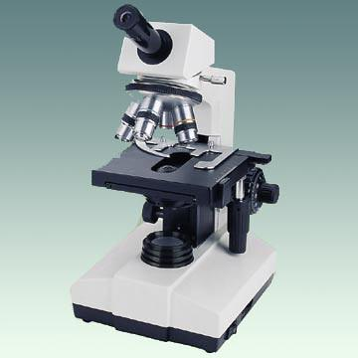
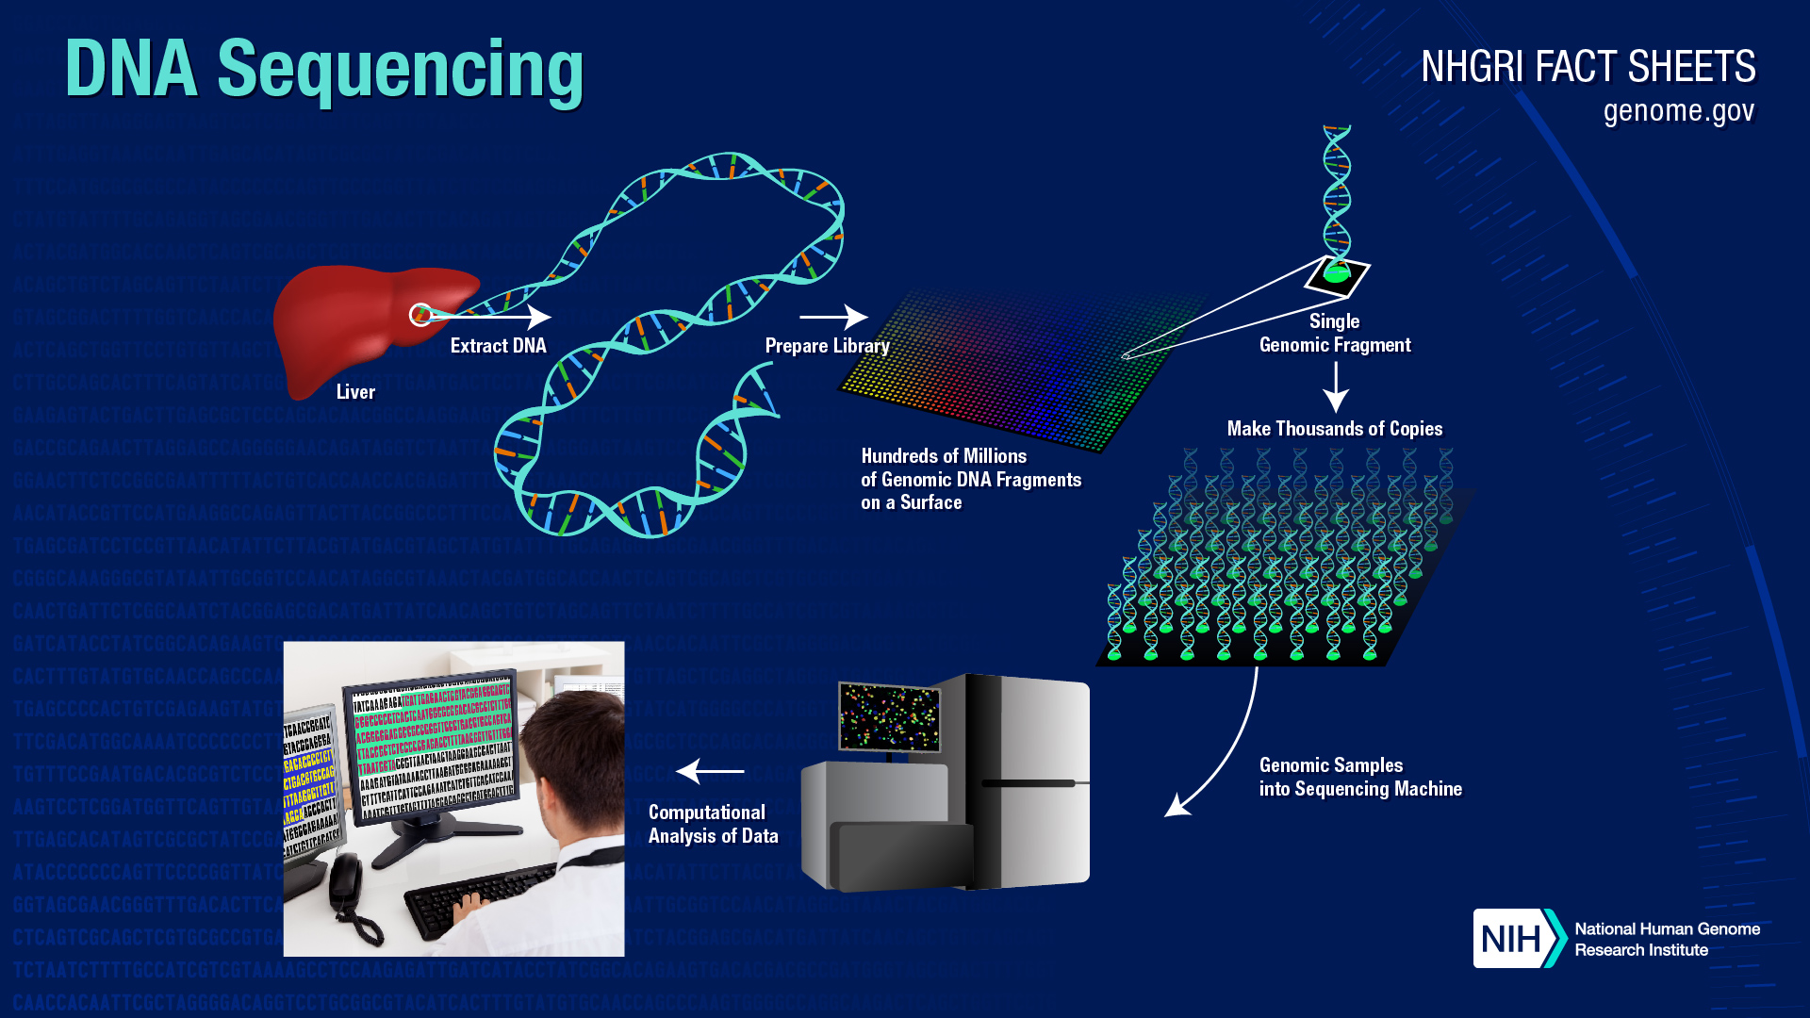
The keys to living longer with cancer are not found at its location
Traditional Cancer Dx Light Microscope
Modern Cancer Dx DNA Sequencer
Notes:
People need to know that with metastatic disease, the location of the primary tumour is no longer important.
The traditional microscope (about 170 years old), as good as it is, only tells us the physical characteristics of cancer. NOT good enough anymore.
People need to know that cancer is a disease of the genes and understanding the biology of the cancer through molecular profiling and WGS are the keys….
What makes it tick? What makes it grow? What are its weaknesses?
Drove me to delve deeper into the world of precision medicine and the incredible value that it represents for patients and their families

Slide 12

On The Other Side of TERMINAL
Notes:
So I set out on a project to write a BOOK about my experience
Wanted to create a legacy for our children, our families and the cancer community.
I wanted there to be something of permanence after I’m gone.
Something that my kids can turn to and read as they progressed through their life.
March of 2022, I Published On the Other Side of TERMINAL

Slide 13
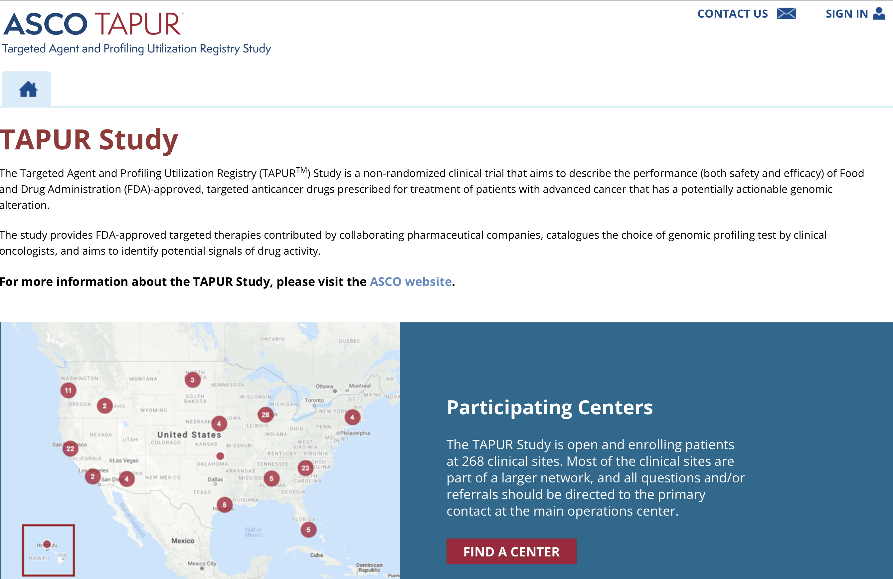
ASCO TAPUR Molecular Tumour Board Member (Patient Advocate)
Notes:
People from across the cancer landscape started reaching out to me.
I received an email from an ASCO employee who works on their flagship trial called TAPUR (matching trial)
Asked if I was interested in representing the patient voice on their molecular tumour board.
The patient voice…we’ll get to more on that soon

Slide 14
The Princess Margaret Cancer Foundation

Slide 15
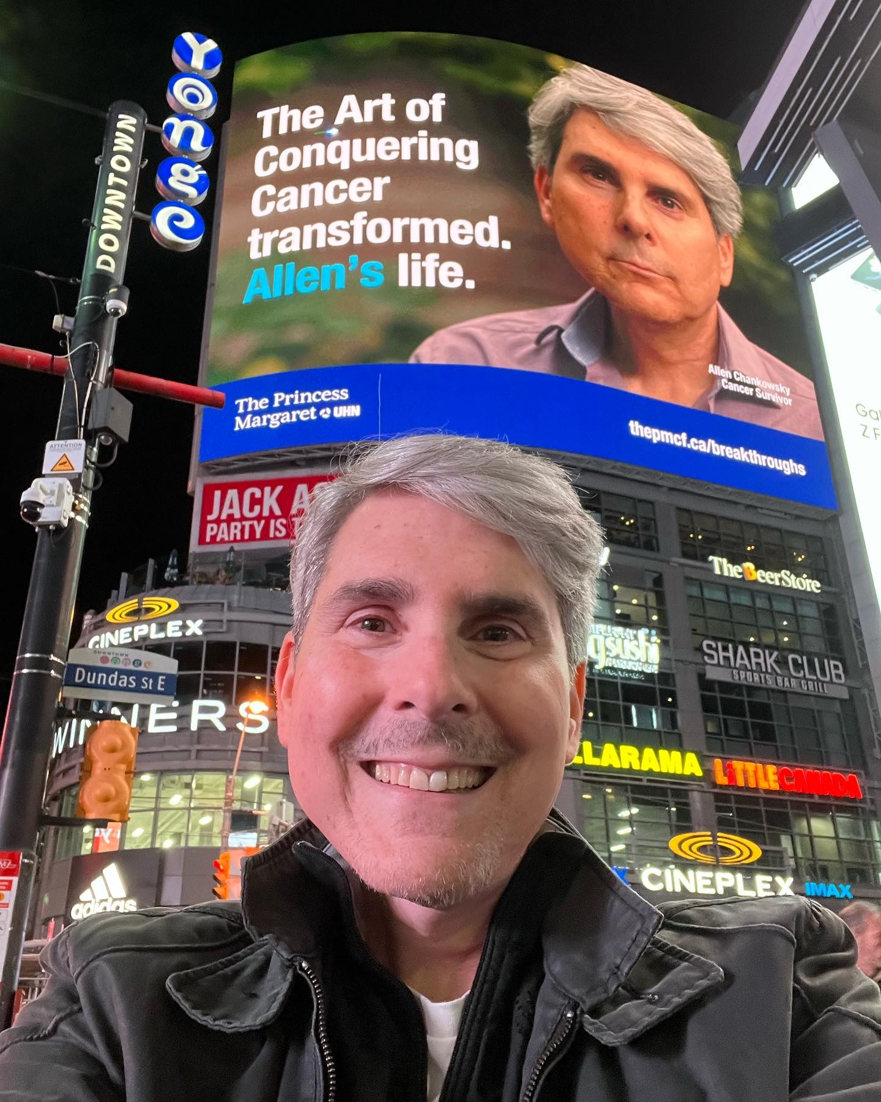
Best Selfie – Ever !!!

Slide 16
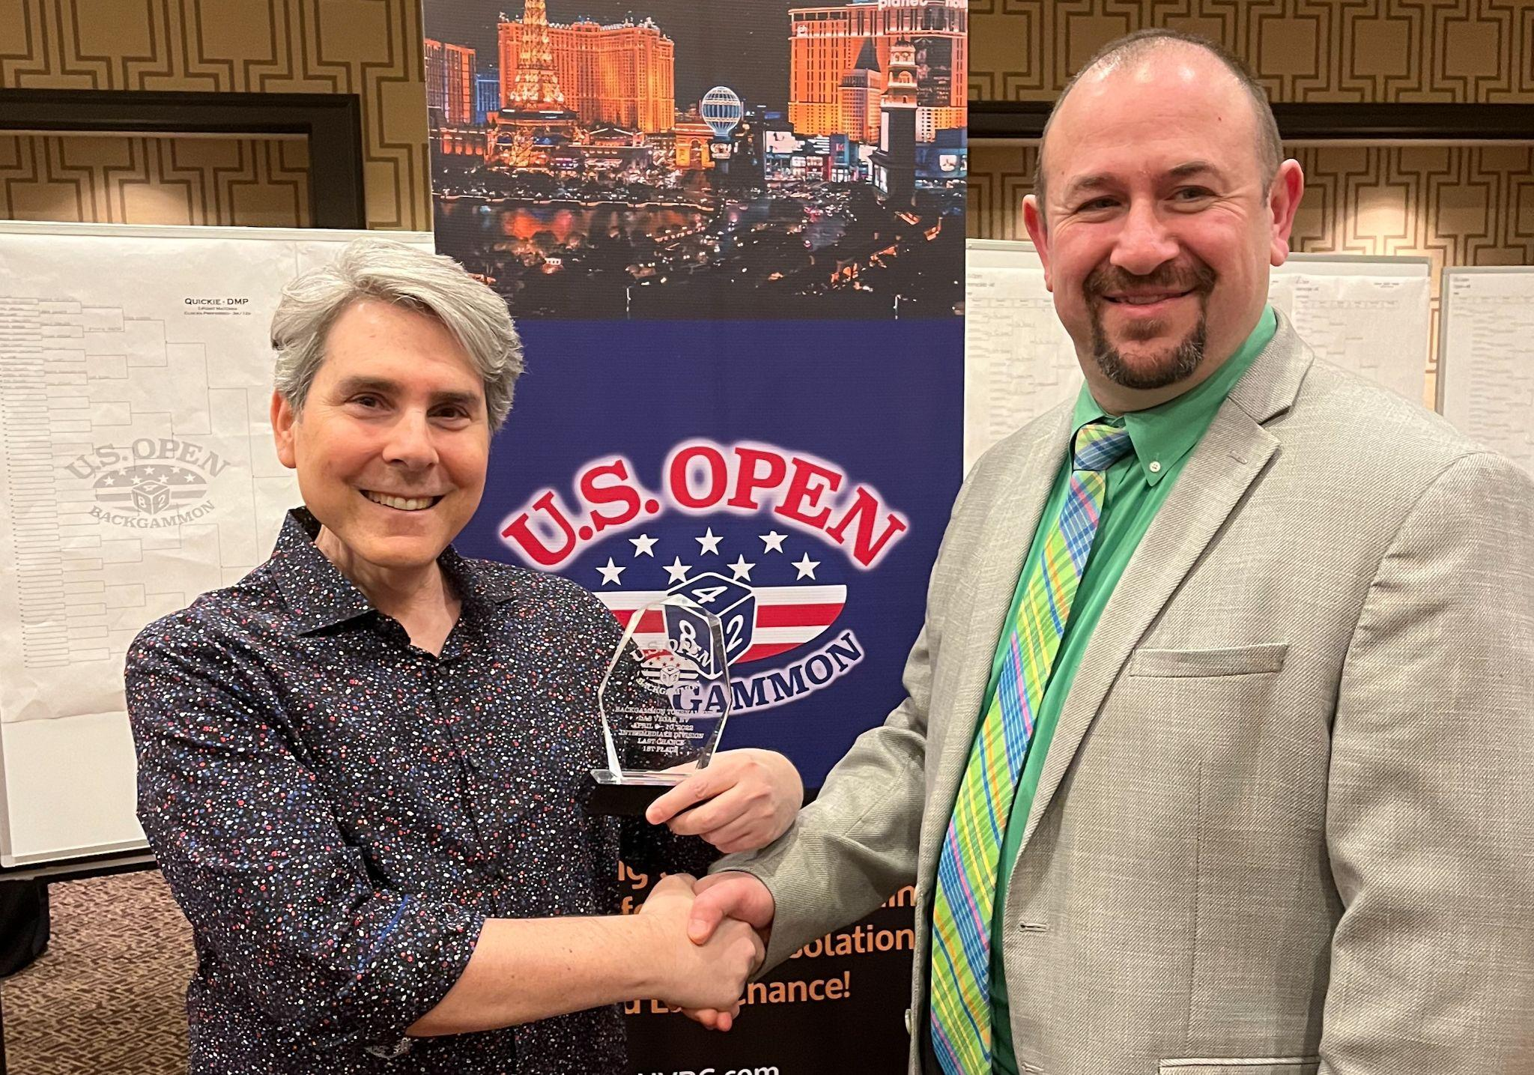

The Magic of Backgammon
Notes:
2.3 percent story
Backgammon had become an active symbol of my survival
That even if the stats dictate the overwhelming odds that you’re going to lose, you NEVER give up. You keep playing….

Slide 17
A shining example of an innovative
decentralized clinical trial in the United States

Slide 18
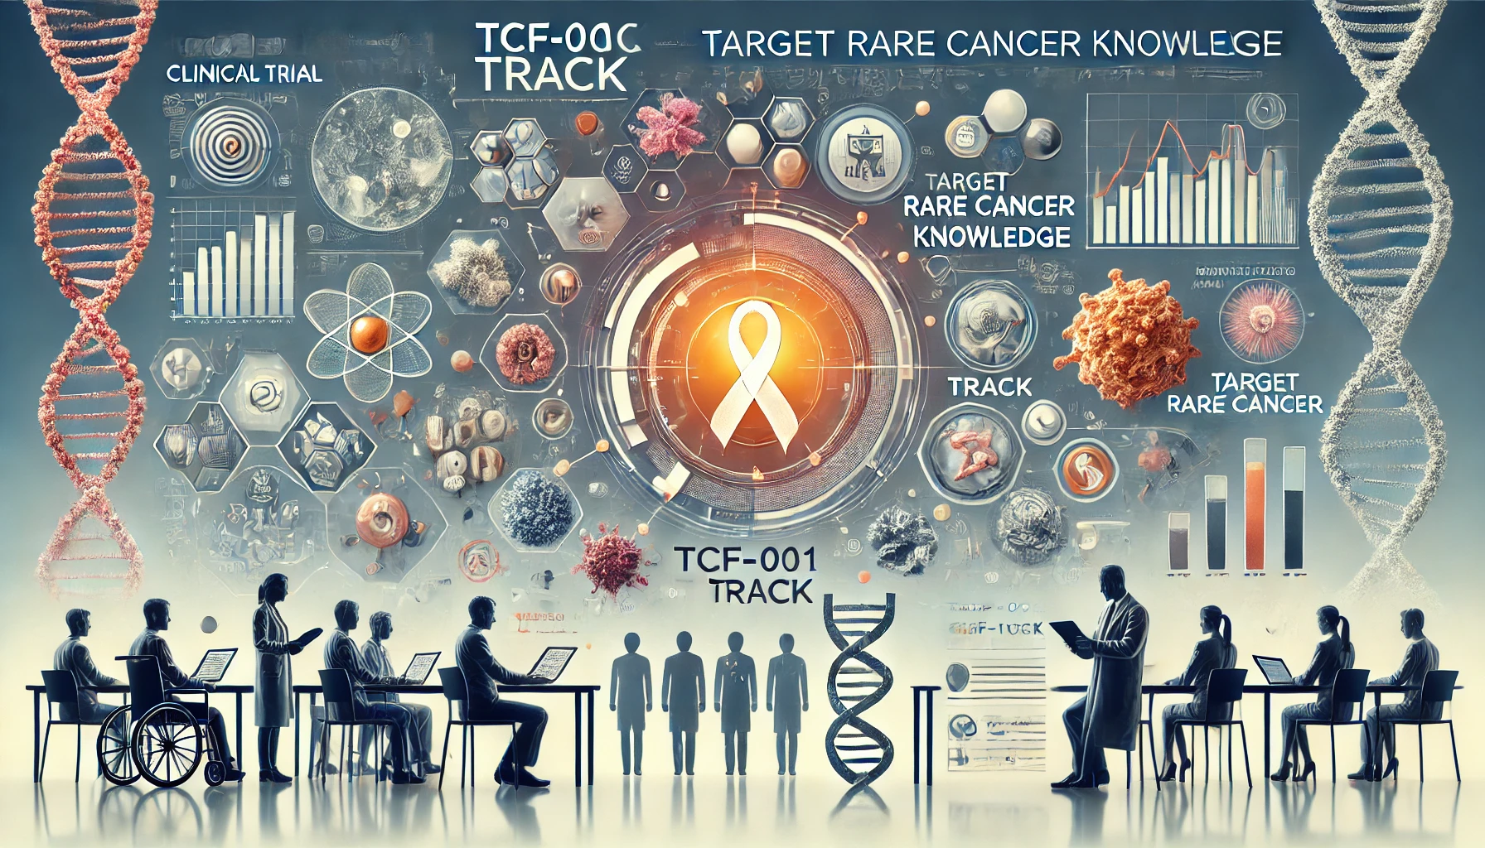
TCF-001 TRACK (Target Rare Cancer Knowledge) is a prospective clinical study (NCT04504604), enrolling 400 patients with rare cancers and cancer of unknown primary.
Notes:
TargetCancer Foundation –
Founded on the basis of the unmet needs of Rare Cancer patients
About a quarter of all cancer cases are considered rare – that’s a big number
So there’s a substantial unmet need
Enter TCF and TRACK

Slide 19

TCF-001 TRACK Trial Components
Virtual MTB
Remote Consenting
Convene a virtual expert Molecular Tumour Board (MTB) and provide treatment recommendations (including clinical trials).
Utilize remote consenting to expand study geographic reach and encompass patient populations in community settings.
Research and Impact
Genomic Profiling
Track impact of treatment decisions based on CGP findings and MTB recommendations on outcomes for one year; repeat FoundationOne Liquid CDx 2-3 times. Develop data to characterize the genomic landscape of rare cancers.
Perform Comprehensive Genomic Profiling of tissue and blood (FoundationOne® CDx & FoundationOne® Liquid CDx) at no cost; return actionable results to the treating physician and patient.
Abbreviations: CGP = Comprehensive Genomic Profiling FDA = Food & Drug Administration MTB = Molecular Tumour Board

Slide 20



Remote Participation (Central IRB)
Remote Participation
Enrollment
End Points
Enroll 400 ⇨ 100 (genome-matched to treatment)
Primary
PFS; % Patients Matched to Therapies
200 patients: All rare cancers (solid tumors and lymphomas), incidence of <6 per 100k
Secondary
Overall Response Rate; % Patients w/Genomic Alterations; Response Duration; Overall Survival; Clinical Benefit Rate (SD ≥ 6 mo., PR, CR); High-grade Toxicities (as available)
100 patients:
Cholangiocarcinoma
Exploratory
100 patients:
Cancer of Unknown Primary
TTF; Matching Rates; Genomic Correlates of Response; CGP Concordance Rates: Tissue + Plasma (cfDNA); PRO (ESAS)
US patients, 18 and older
Abbreviations:
cfDNA = cell-free DNA; CGP = Comprehensive Genomic Profiling; CR = Complete Response; ESAS = Edmonton Symptom Assessment System; IRB = Institutional Review Board; PFS = Progression-Free Survival;
PR = Partial Response; PRO = Patient Reported Outcomes; SD = Stable Disease; TTF = Time to Treatment Failure

Slide 21


Slide 22




How TRACK Works?
Step-4 (Ongoing Engagement)
Step-1 (Learning at Home)
Ongoing engagement. Over the year, the TCF team collects updated study-related medical information and asks patients to provide additional blood samples for repeated CGP to identify new alterations for potential treatment recommendations.
Learning about TRACK begins at home. After providing initial information, interested patients will have an introductory phone call with TCF study staff to discuss TRACK and confirm eligibility, then have the option to fully consent via an online process.
Step-3 (Recommendations)
Step-2 (TCF Coordination)
Recommendations provided. CGP reports on tissue and blood are returned to the TCF team and the patient’s physician. The TRACK Virtual Molecular Tumour Board, composed of leading rare cancer experts, reviews the data and provides treatment recommendations to the physician.
TCF takes it from there. Once a patient enrolls, the TCF study team reaches out to treating institutions or medical offices to secure medical records and facilitate comprehensive genomic profiling (CGP) of tissue and blood.

Slide 23
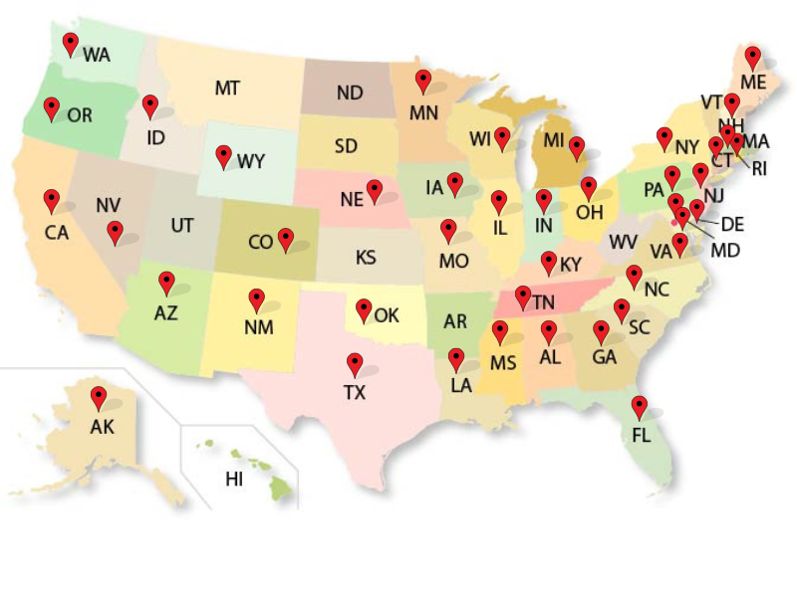
As of today
Over 200 patients enrolled
41 US states represented
More than 51 types of rare cancers

Slide 24
Patient Impact | Field Advancements
Comprehensive Genomic Profiling (no cost) | New insights into biology & molecular landscape
Improved (+ ~real-time) monitoring of disease state & treatment effectiveness | New genome-defined subtypes
Expert, multi-disciplinary, individualized treatment guidance | Drive novel drug combinations
Expanded, bespoke treatment options & access to targeted/informed drugs | Support evolution & expansion of standard(s) of care to include CGP
Potential improved outcomes (e.g. Quality of Life, Progression- Free/Overall Survival) | Illuminate histology-dependent & histology-independent outcomes
Notes:
I was in attendance when TRACK was presented at ASCO24 this year and it’s generated wide interest

Slide 25
An example of a Canadian patient-centric clinical trial model at the funding stage
Notes:
Received a call from a senior researcher at PMH asking if I would be open to being the patient advocate lead for a rare cancer trial
They needed patient input for the trial design
I read the trial brief and I jumped at the opportunity.

Slide 26

First-of-its-kind Program at
Princess Margaret Cancer Centre
UNICORN (Unique Network In the Comprehensive Ontology of Rare Neoplasms)
Notes:
Don’t get thrown by the UNICORN’s dashing good looks. This is a unicorn that only a rare cancer patient could love
I fell in love with this thing and here’s why

Slide 27
Rationale for a Specialized Program for rare tumours
Delays in Diagnosis
01
Delays in diagnosis contribute to challenges in managing rare tumors effectively.
Rationale for a Rare Tumour Program
Limited Treatment Options
02
Limited standard treatment and clinical trial options restrict effective care for rare tumors.
At Princess Margaret, there are >200 types of rare cancers that comprise >20% of all cancer diagnoses
Research and Funding Limitations
03
Limited research and research funding, along with limited educational information, hinder advancements.
Support Services and Disparities
04
Limited psychosocial support services and health disparities can lead to even greater marginalization of rare tumors.
Notes:
It’s a specialized program for rare cancers
It addresses the pain points that rare cancer patients face

Slide 28
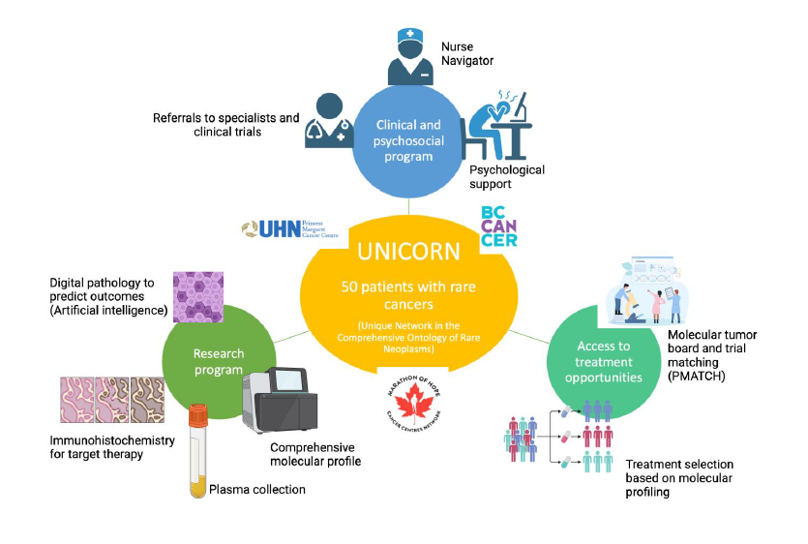
UNICORN Pathway
Unique Network In the Comprehensive Ontology of Rare Neoplasms (UNICORN)
Program Leads
Enrique Sanz-Garcia (MD)
Lindsay Carlsson (RN, MN, PhD)
Lillian Siu (MD)
Allen Chankowsky (Patient Advocate)
Notes:
Pt’s are referred from either UHN or BC Cancer.
Once consented, they are assigned a nurse navigator
Psychosocial supports are set up
Clinical records are obtained
Bx’s secured and analyzed with the most comprehensive molecular testing available

Slide 29
Novel Therapeutic Strategies for Rare Tumors in Collaboration with Canadian Cancer Trials Groups
Whole Genome Transcriptome Sequencing (DNA + RNA) + Immunostains (Protein)
01
Antibody Drug Conjugate Basket 1
Surgery or Fresh Biopsy
02
Antibody Drug Conjugate Basket 2
Rare tumours (incidence of 6/100,000 per year)
03
Antibody Drug Conjugate Basket 3
Drug targets identified by DNA, RNA or Protein
04
Catch all – e.g., Immunotherapy combo
Notes:
Comprehensive RNA, DNA and transcriptome sequencing are conducted as well as confirmatory IHC protein testing
The goal is to match the patient to one or more therapeutics via a molecular tumour board that is unique to UNICORN and will include a:
pharmacogenomicist,
Med Onc’s
Radiologists
Surgical oncologists
Last but not least, Patient advocates to represent the all-important patient voice

Slide 30
01
Multidisciplinary Care
All encompassing: multidisciplinary and patient-centric approach for comprehensive care and improved outcomes.
02
End-to-End Management
End-to-end care starting with diagnosis and covering treatment, supportive care, and research for full patient support.
What makes UNICORN Unique
Early and Advanced Cancers
03
Exploring early and advanced rare cancers for broader coverage, whereas most programs focus on advanced-stage disease only.
04
Data Integration
A wealth of data will collect and integrate clinical, molecular, and radiologic data for informed decisions.
05
Access and Support
Enabling access through support from pharmaceutical companies, clinical trial opportunities, and care by a Nurse Navigator.
Notes:
Proposal includes a pharmacogenomicist who will sit on the tumour board to advise on appropriate drug combinations
Patient-centric

Slide 31

The Patient Voice and the Future of Clinical Trials
Notes:
I’ve shared how I’ve used my voice to not only save my life
I’ve shared how the patient voice is being incorporated into tumour boards and into clinical trials
The only question now is, what are YOU going to do to incorporate the patient voice into more clinical trials?
Thank you

Slide 32

Any Questions?

Slide 33
Thank You!
Presented by:
Allen Chankowsky
November 6, 2024
@allenchankowsky

