Slide 1

Updates - Clinical Trials at the Canadian Institutes of Health Research
Clinical Trials Ontario Conference
November 6, 2024

Slide 2



Building CIHR’s clinical trials program
Priority E: Integrate Evidence in Health Decisions
  E.3.3 Enhance Canada’s capacity to fund, conduct and use clinical trials by strengthening highly qualified personnel, clinical trials environments and research investments
Priority A: Advance Research Excellence in All Its Diversity
  A.3.3 Promote monitor and report on CIHR-funded researcher compliance with the WHO statement of Public Disclosure of Results from Clinical Trials
Implement the Clinical Trials Fund
Under Canada’s Biomanufacturing and Life Sciences Strategy - focus on pandemic preparedness and a strong domestic life sciences sector
Develop and implement a long-term clinical trials strategy
Notes:
CIHR’s clinical trial programs primarily fall under priority E

Slide 3
Clinical Trials Fund: now fully allocated
Three inter-related building blocks form the CIHR Clinical Trials Fund
A clinical trial platform to coordinate, increase efficiency, and catalyze sustainable infrastructure
~$39 million awarded to the Accelerating Clinical Trials Consortium, funded until August 2025
Platform
  Operating grants to fund CTs in priority areas
  ~$60M awarded to 22 projects aligned with BLSS priorities, funded until August 2025
  ~$41M awarded to 14 projects aligned with BLSS priorities, funded until March 2027
ROBUST TRIAL ECOSYSTEM
Training grants to develop highly qualified personnel in CT research
$25.5 million awarded to 5 training platforms, plus contributions from the Strategy for Patient Oriented Research to support 2 additional training platforms, funded until August 2025
People
Projects
Dedicated support for indirect costs of research
Internal CIHR resources

Slide 4
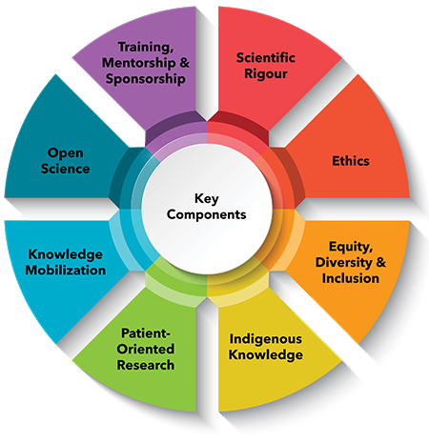
Policy development – building better clinical trials
Applying CIHR’s research excellence framework to clinical trials, we have published best practices recommendations, including:
Inclusion of populations and justifications of any exclusions
Equity, diversity, inclusion and accessibility considerations in trial planning
Diversity in data – describing the trial populations in results and providing disaggregated results where valid to do so
Patient-oriented research approaches in all stages of trial design and implementation
Knowledge mobilization planning
Open science – enabling secondary use of data, disclosure of protocols
Use of standardized approaches such as core outcome sets to improve comparability
Developing and supporting diverse research teams
Using available processes to improve clinical trial efficiency, including streamlined REB and contracting processes
Implementation of these elements as mandatory application requirements would require the development of additional guidance for applicants and reviewers, as well as ongoing resources to monitor and evaluate.

Slide 5
Supporting transparency - clinical trials registration and disclosure policy
In October 2020, CIHR signed onto the WHO Joint Statement on Public Disclosure of Results from Clinical Trials, with the following requirements applicable to all clinical trial grants funded on or after January 1, 2022:
clinical trials must be registered in a publicly available, free to access, searchable clinical trial registry complying with WHO’s international agreed standards before the first visit of the first participant*
publications describing clinical trial results must be open access from the date of publication;
public disclosure of results must be done within a mandated time frame: summary results must be publicly available within 12 months from the last visit of the last participant (for collection of data on the primary outcome); and,
all study publications must include the registration number/Trial ID (to be specified in the article summary/abstract). N.B. These publications must include an acknowledgement of CIHR contributions and the Funding Reference Number (FRN) or Application ID, as per the Tri-Agency Open Access Policy on Publications
In addition to the new requirements, CIHR committed to monitoring and reporting on compliance annually.
* Requirement had previously been in place but was not actively monitored
Source:
CIHR Policy Guide – Requirements for Registration and Disclosure of Results from Clinical Trials - CIHR (cihr-irsc.gc.ca)

Slide 6
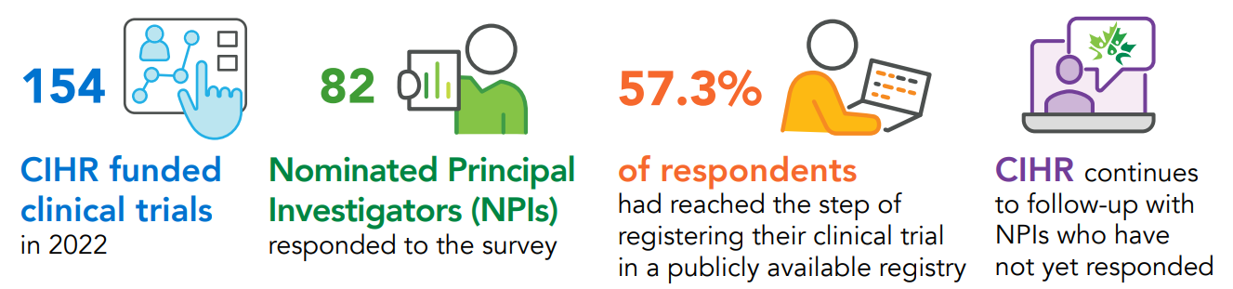
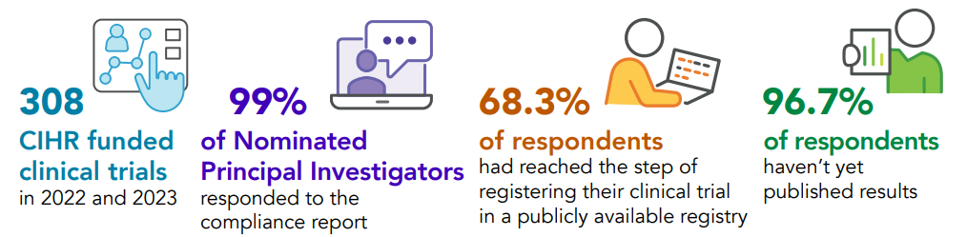
Gradual system and culture change
First monitoring cycle
(trials funded in 2022)
Second monitoring cycle
(trials funded in 2022 and 2023)
Next steps – continued process improvement, including addressing instances of non-compliance

Slide 7
What’s next?
Continued monitoring of CTF grants – progress and impact
Continued implementation of registration and disclosure monitoring processes
  Assuming ~150 new trials funded each year, and 4-5 years to complete all policy requirements, could anticipate steady state of ~750-1000 trials to be monitored each year on an ongoing basis
  Greater automation to be incorporated with ongoing evolution of the tri-agency grant management system
Determination of which best practices policy elements could be made mandatory with current resources, including consideration of whether some (e.g., reporting disaggregated data, and publishing protocols) could be build into an expanded registration and disclosure policy

Slide 8


Canada’s Strategy for Patient-Oriented Research (SPOR)
Vision
Strategy
“By 2025, Canada will have demonstrably improved health outcomes and enhanced the health care experience for patients through the integration of evidence at all levels of the health care system.”
Engagement of patients and other knowledge users to maximize relevance of research
Partnered funding to increase reach, buy-in and knowledge mobilization
Investment in capacity building to grow the skills, knowledge and relationships required to sustain patient-oriented research
Investment in infrastructure to enable patient-oriented research
Notes:
Established 2011
To achieve this vision, SPOR operates with key strategic approaches and guiding principles.
SPOR funds and supports effective collaboration between patients, partners, researchers, health care providers, and policy makers. It acts as a catalyst for patient-oriented research in several ways:
SPOR facilitates research by creating environments that are conducive to patient-oriented research across Canada.
SPOR directly funds research in a number of areas.

Slide 9




















What does SPOR Fund?
11 SPOR SUPPORT Units
6 Chronic Condition Networks
1 Canadian Primary Care Research Network
  11 Research Networks across Canada
Cross-cutting platforms:
  SPOR Evidence Alliance
  National Training Entity (Passerelle)
  SPOR Canadian Data Platform
Innovative Clinical Trials
Nunavut SPOR SU
SPOR Canadian Data Platform

Slide 10
SPOR Refresh: A Renewed Approach for the Strategy
Key Themes
Why now?
For over a decade, SPOR has driven patient-oriented research in Canada. However, a refreshed approach that builds on past successes and responds to today’s challenges is needed.
Strengths and Challenges of the Program
Future Trends and Emerging Needs
Accelerating Indigenous Self-Determination in Research
Promoting Equity, Diversity, Inclusion, Anti-Racism, & Accessibility
Building Capacity for Excellence in Patient-Oriented Research
Strengthening Collaboration with Policymakers for Greater Impact
Strengthening Governance
Refresh Activities
39 partners leading discussions within their networks
13 Pan-Canadian virtual roundtables with 220 participants
Online platform with over 5,000 visits & 470 contributions
Next Steps
A set of recommendations for a refreshed SPOR will be shared back with the community late fall 2024 or early winter 2025

Slide 11


A summary report on the data gathered on each of seven engagement themes has been published on the NAPHRO website: www.naphro.ca/spor
To receive the latest updates on the SPOR refresh, visit our website https://cihr-irsc.gc.ca/e/53699.html, consider subscribing to our SPOR newsletter or follow CIHR on our social media channels.

Slide 12
Budget 2024 – new investments in research
Increased funding for core research grants - $1.8 billion over five years, starting in 2024-25, with $748.3 million per year ongoing to CIHR, NSERC, and SSHRC
Harmonized grant management system - $26.9 million over five years (starting in 2024-25, $6.6 million ongoing)
$10 million in 2024-2025 for CIHR to support an endowment to increase prize values awarded by the Gairdner Foundation for excellence in health research
$825 million over five years (starting in 2024-25, with $199.8 million per year ongoing) to increase the annual value of master’s and doctoral student scholarships to $27,000 and $40,000, respectively, and post-doctoral fellowships to $70,000
Increase the number of research scholarships and fellowships provided, building to approximately 1,720 more graduate students or fellows each year
Scholarships and fellowship programs to be streamlined into one talent program
$30 million over three years, starting in 2024-25, to support Indigenous participation in research, with $10 million each for First Nation, Métis, and Inuit partners

Slide 13
Budget 2024 – creation of a new capstone research organization
The Advisory Panel on the Federal Research Support System (the “Bouchard report”) recommended more coordination to maximize the impact of federal research support across Canada’s research ecosystem
Budget 2024 announced that the government will create a new capstone research funding organization
CIHR, NSERC, and SSHRC will continue to exist within this new organization
The new organization will:
  maintain strong connections to the federal Health portfolio to ensure that health priorities are integrated into the organization – particularly in the event of health emergencies
  retain the CIHR institute model
  help improve support for research that transcends disciplinary and sectoral boundaries, enabling Canada to better respond to emerging domestic and global challenges and opportunities, such as climate change, transformative technologies such as AI, and preparing for an aging population
  help to advance internationally collaborative, multi-disciplinary, and mission-driven research
Consultation feedback published Oct 16th: What We Heard: Tri-agency engagement with the research community on modernization of the federal research support system - Canada.ca
More details will be announced in the 2024 Fall Economic Statement

Slide 14

clinicaltrials-essaiscliniques@cihr-irsc.gc.ca

