Slide 1
Reducing Barriers:
Equity and Diversity in Clinical Trials
Michelle Audoin
OICR PFAC, 3CTN Patient Partner, CCTG Patient Representative
Notes:
Good afternoon, welcome to my talk entitled Reducing Barriers: E & D in CT
My name is…
These are just a few of the organizations where patient partners have an impact on CTs in Canada
Given that we are all here at this conference to discuss issues and insights that are critical to the development and success of clincal trials,
I want to jump right in with some basic questions that can often get lost in the process…
And that is (next slide)

Slide 2
Who are the experts in CT? Who are trials for?
Who I am
Who I am not
Mom
Teacher
Living with mBC and thyroid cancer
Academic researcher
Clinical trialist
Any kind of medical professional
Notes:
So, I am an expert in my living experiences, my needs my priorities.
And that alone should matter.
I understand that researchers and scientists play a critical role…they bring expertise and expand our understanding of science and try to solve important problems…
But ultimately, I like to believe and hope that the CT are really for everyday people like me. Because my life matters and so does everyone else‘s
I believe that everyday people like me bring valuable insights to the CT landscape and I want to help drive systemic change.
(next slide)

Slide 3
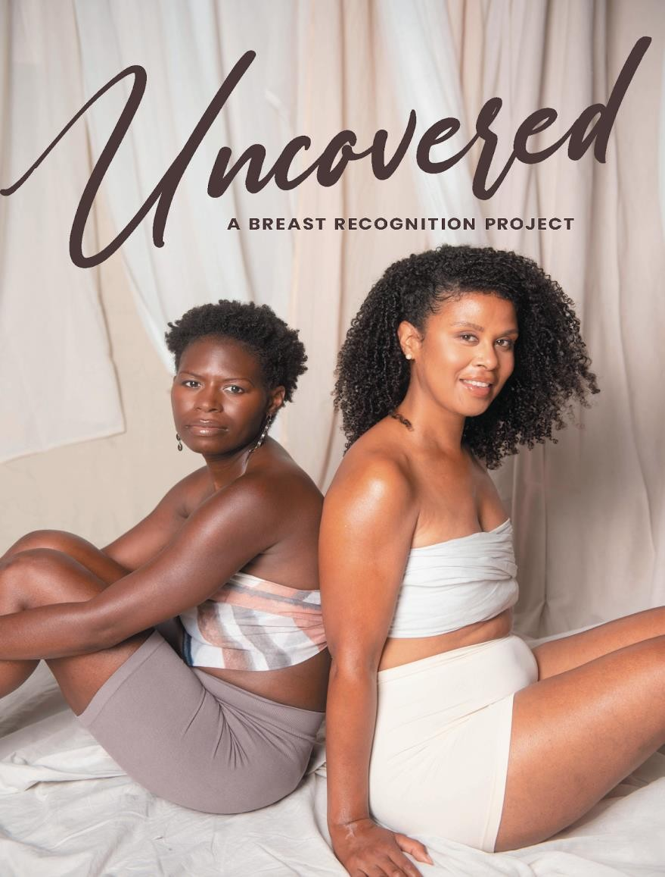
My Journey: From Awareness, to Advocacy, To Action
2017 de novo mBC + thyroid cancer diagnoses
Resources and information about breast reconstruction for Black women??
1st collaboration: Created Uncovered: A Breast Recognition Project
Rapid progression and failed treatments but no access to clinical trials
Started to advocate for unmet needs for mBC and systemically underserved communities
Systemic change is slow and I want to play an active role
Action plan:
Attend conferences
Build community and connections
Engage with key stakeholders
Notes:
So, some of you may be wondering how do I manage all these patient engagement opportunities while living with cancer?
First of I AM living with cancer. I don’t live for cancer or nor am waiting for it to take over my life.
Secondly, thanks to the nature of the beast, I have a lifetime supply of blister pack meds and prescription to treat the side effects of side effects…it’s that data from CT that help me live a dignified QOL. But if I lose my focus or my words, I’m pulling the cancer card, because that’s my reality.

Slide 4
Moving EDI Forward in Trials - 3CTN Initiatives
Provided expertise and strategic advice as a Person With Living Experience (PWLLE)
Identified equitable best practices and practical resources with the EDI Working Group Members
Shared my learnings with others
EDI Working Group Members
Michelle Audoin
PFAC, Ontario Institute of Cancer Research
Anna Johnson
Canadian Cancer Trials Group
Tina Hsu
University of Ottawa
Doreen Ezeife
Tom Baker Cancer Centre
Holly Longstaff
Provincial Health Services Authority
Vinesha Ramasamy
AYA CAN - Canadian Cancer Advocacy
Evani Goll
C17 Pediatric Council
Laura McNab-Coombs
BC Network Environment for Indigenous Health Research
Roel Schlijper-Bos
BC Cancer – Prince George
Notes:
Project member and Patient Partner for 3CTN EDI Working Group and Steering Committee. Along with clinical researchers, oncologists, patient partners and EDI experts, 3CTN co-developed an Equity, Diversity and Inclusion Framework and a guide to Improve Trial Access for Indigenous Peoples.

Slide 5
3CTN EDI Framework and Resource Toolkit
Framework Themes:
Improving Trial Participation – Fostering Trust and Improving Communication
Improving Trial Awareness
Improving Trial Access
Developing Inclusive Trial Design
Education and Training for Clinical Research Staff
Increasing Diversity of Clinical Research Teams and Inclusive Hiring Practices
Collection of Trial Participant Data – Race, Ethnicity, Demographic Data
Notes:
The EDI Framework recommendations were developed to help members identify meaningful opportunities in their efforts to improve equitable access and participation in clinical trials for underrepresented populations and improve the diversity and inclusiveness of Canada’s clinical research community. The Toolkit was designed to allow users to identify available resources, templates, and guidelines associated with each set of recommendations in order to implement best practices that are most relevant for overcoming challenges.

Slide 6
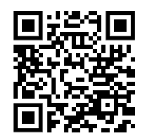
Putting Best Practices to Practice
EDI Framework + Toolkit
CRAFT Framework
Demonstration Projects
Foundation - Framework, Guideline and Templates
Pilot cancer centres to implement EDI Best Practices
Building on 3CTN’s early CRAFT (Canadian Remote Access Framework For Clinical Trials) successes and the recently launched EDI Framework
3CTN to support projects for implementation of EDI priorities at Cancer Centres
Increase potential for enrollment of underserved populations
Provide funding to drive meaningful changes in trial conduct and patient access
Evaluate and assess impacts
EDI Framework
CRAFT Framework
Notes:
Involved in developing guidelines and evaluation criteria for the EDI Demonstration Project Application. Part of the Review Panel – reviewed applications to select projects that will move forward. Announcement of projects to come in the next few weeks.
CRAFT (Canadian Remote Access Framework For Clinical Trials) - a framework that helps enable clinical trial participation for patients who live far from the healthcare site where the trial is primarily offered (i.e providing care closer to home).

Slide 7
Blind Spots and Barriers: Parallels to Education
Data Collection
Representation
Whom are we collecting data on? What data are we collecting? Language matters! Accessibility of the process How is this data being shared back with the community in a timely manner?
Do staff reflect the diversity of the community? Do resources reflect diversity and are they authentic? How do we create safe, welcoming and inclusive environments?
Notes:
For 17 years, I taught at the same school in the largest and one of the most diverse public school boards in Canada.
The community was mainly recent immigrants
They faced:
Language barriers
Cultural barriers
Lack of understanding of the systems
Employment, housing, and food security issues
So, there are 2 prominent blind spots and barriers that Keep coming up in CT that remind me of teaching…Data Collection and Representation
From my perspective, these barriers to equity and diversity in CT boil down to what I refer to as the 3Ms…mistrust, misunderstand, and misinformation. We must work together to address them to eliminate the barriers.
(Next slide)

Slide 8
Thank you!
CTO and conference organizers
The distinguished panelists at this session
Organizations that are leaders in patient engagement and partnerships in research:
OICR
3CTN
CCTG
Raisa Chowdhury at 3CTN
Notes:
I don’t want to take up any more of your time. We have 3 amazing panelists who will be providing valuable insights momentarily,
However, I’d be remiss to not acknowledge a few of the organizations that I have the pleasure of being a part of. The list is not exhaustive of my engagements and the amazing work that’s happening.
And lastly, Raisa
And without further delay , I’d like to introduce our first panelist..

